Slide 1
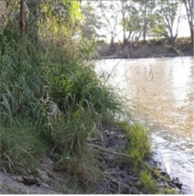
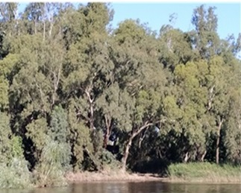
Modelling floodplain vegetation responses
to surface water availability using remotely sensed data in southeast Australia
Newton Muhury
School of Surveying and Built Environment,
University of Southern Queensland
Australia
newton.muhury@usq.edu.au

Slide 2
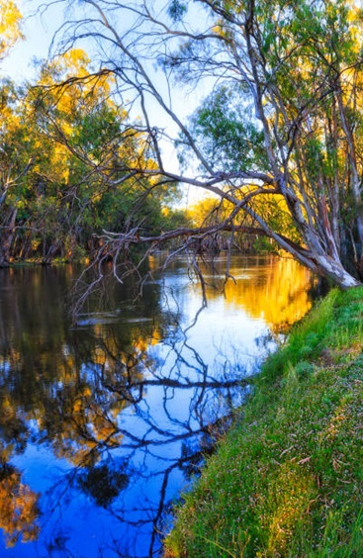
Presentation outline
Introduction
Objectives
Methods and data
Results and discussion
Conclusion

Slide 3
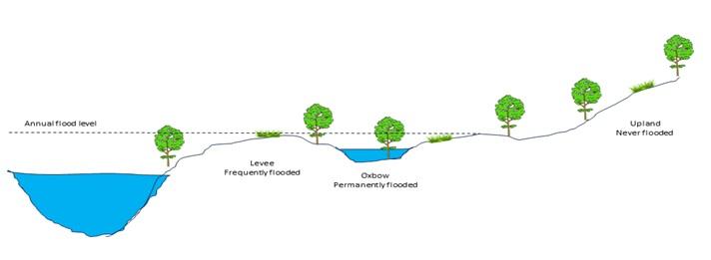
Introduction
Global climate change altering the hydrological cycle.
Floodplain vegetation depends on catchment hydrology.
Floodplain ecosystems are endangered due to changing climate.
Fig 1: Conceptual diagram of a river floodplain area

Slide 4
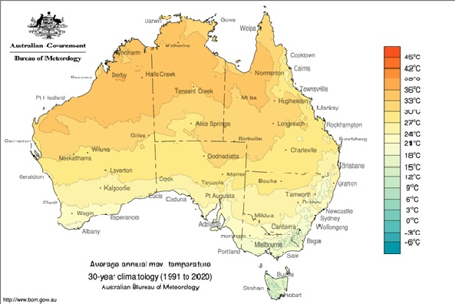
… Introduction
An average increase in air temperatures by 0.85 °C between 1880 and 2012 (IPCC, 2014).
Australia is also facing significant climate change impacts.
Increasing temperatures can lead to high evaporation and transpiration rates.
Shifting precipitation patterns can lead to drought and extreme flood events.

Slide 5
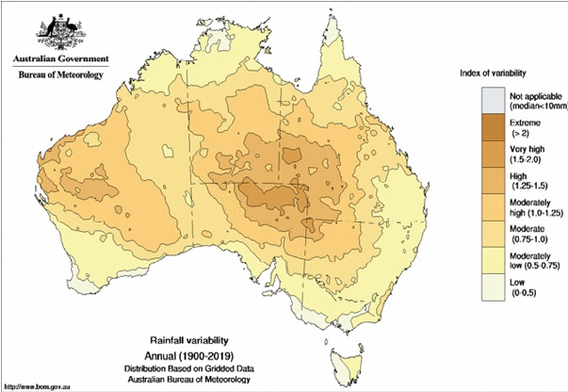
... Introduction
Australia could rise between 0.5°C and 2.5°C in the next 50 years (IPCC, 2021).
The temperature change influences humidity and evapotranspiration.
The precipitation change directly impacts catchment runoff.

Slide 6
Objectives
The specific objectives of this study are:
to understand different types of vegetation responses against surface water availability at the catchment level; and
to build regression models for the relationship between different vegetation responses (as measured by NDVI) and seasonal surface water availability.

Slide 7
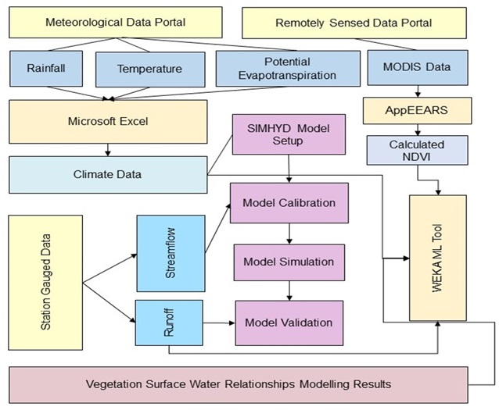
Methods
Figure 2: An overview of the research methodology

Slide 8
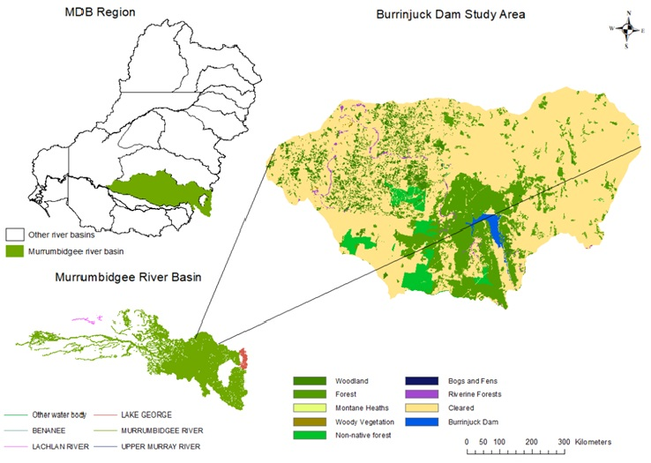
… Methods
Figure 3: The study area, Burrinjuck sub-catchment

Slide 9
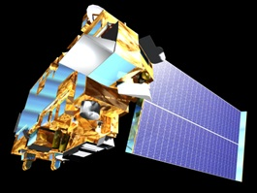
… Methods
Data preparation
Data | Frequency | Description | Source
Precipitation | Daily | Station gauged, temporal | Bureau of Meteorology
Temperature | Daily | Station gauged, temporal | Bureau of Meteorology
Evapotranspiration | Daily | Satellite-derived, 0.05 degree (approximately 5 x 5 km) | Bureau of Meteorology
Runoff | Daily | Satellite-derived, 0.05 degree (approximately 5 x 5 km) | Bureau of Meteorology
Streamflow (discharge) | Daily | Station gauged, temporal | NSW Office of Water
MODIS NDVI | 16-Day | 250 m spatial resolution | U.S. Geological Survey

Slide 10
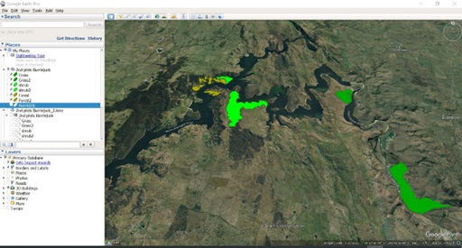
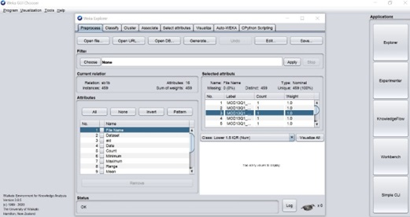
… Methods
Data analysis

Slide 11
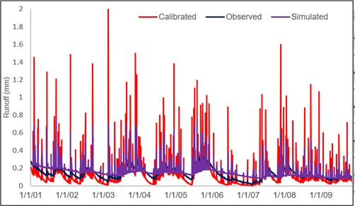
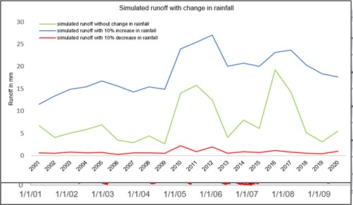
Results
SIMHYD has simulated catchment runoff with an NSE value of 0.95.
Grass is highly responsive to rainfall, runoff, and streamflow (r=0.85, 0.82, and 0.81, respectively) during the dry season.
Shrubs and trees were highly responsive to catchment runoff (r=0.77, and r= 0.75 respectively) during the dry season

Slide 12
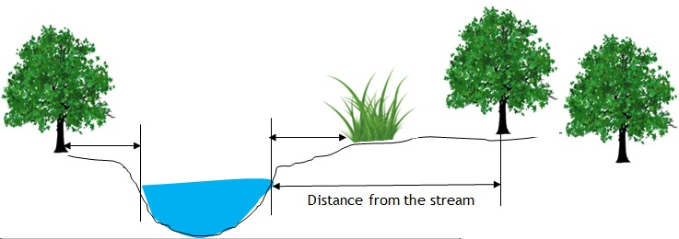
… Results

Slide 13
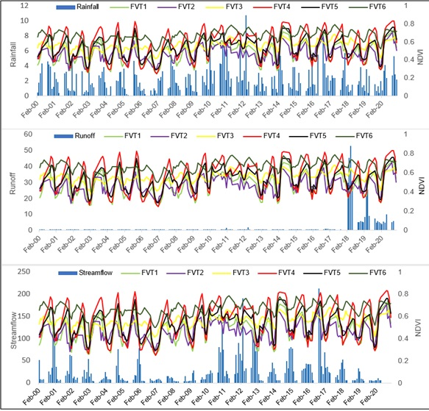
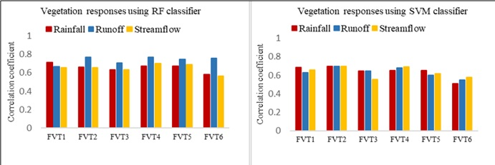
… Results
Regression analysis
 | Rainfall | Runoff | Streamflow
Grass near to the stream | r = 0.75 | r = 0.71 | r = 0.68
Grass distant from the stream | r = 0.85 | r = 0.82 | r = 0.81
Shrub near to the stream | r = 0.66 | r = 0.77 | r = 0.66
Shrub distant from the stream | r = 0.64 | r = 0.71 | r = 0.64
Tree near to the stream | r = 0.67 | r = 0.75 | r = 0.69
Tree distant from the stream | r = 0.58 | r = 0.76 | r = 0.56

Slide 14
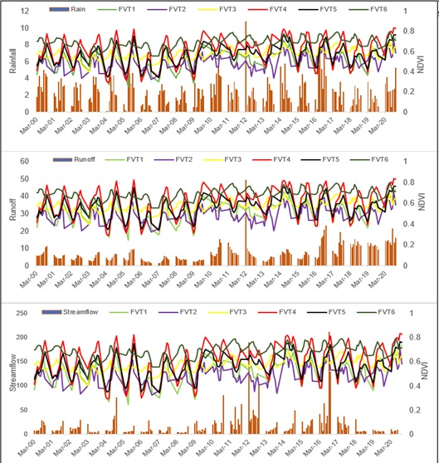
… Results
Grasses respond more to catchment rainfall than shrubs and trees during the dry season.
Grasses and Shrubs are highly responsive to catchment runoff during the wet season.
Trees distant from the stream are more responsive to runoff than the closest ones during the dry season.

Slide 15
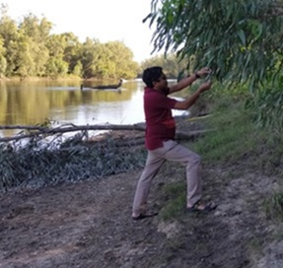
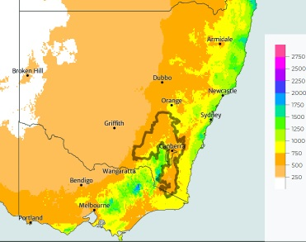
Conclusions
The vegetation response depends on the vegetation types and their proximity to the stream.
Suitable crops can be considered growing during the wet season.
Future rainfall pattern changes need to be considered in the future studies.

Slide 16
Thank you

