Slide 1
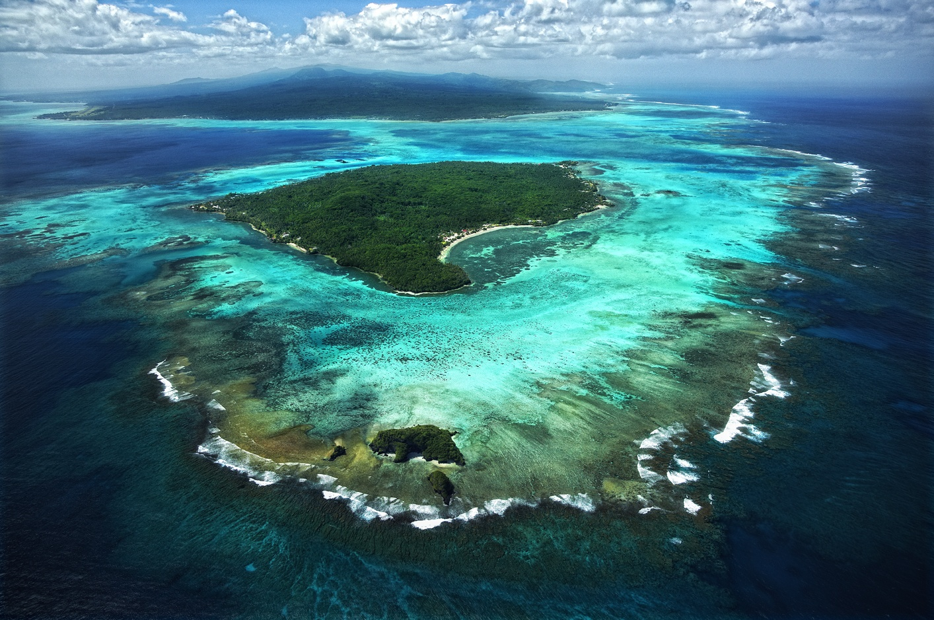
Using Geospatial Tool to inform the needs for Water Security and Protected Area Management.
Ms. Kasaqa Tora
Spatial Analysis Specialist Protected Areas
Secretariat of the Pacific Regional Environment Program (SPREP)

Slide 2
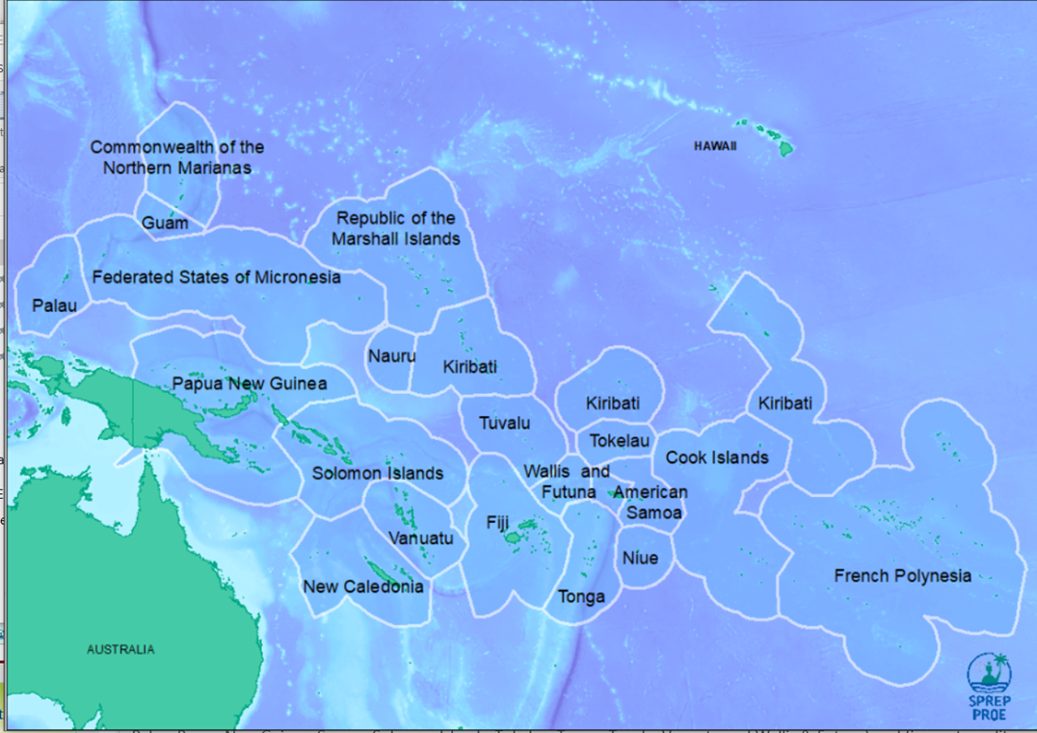
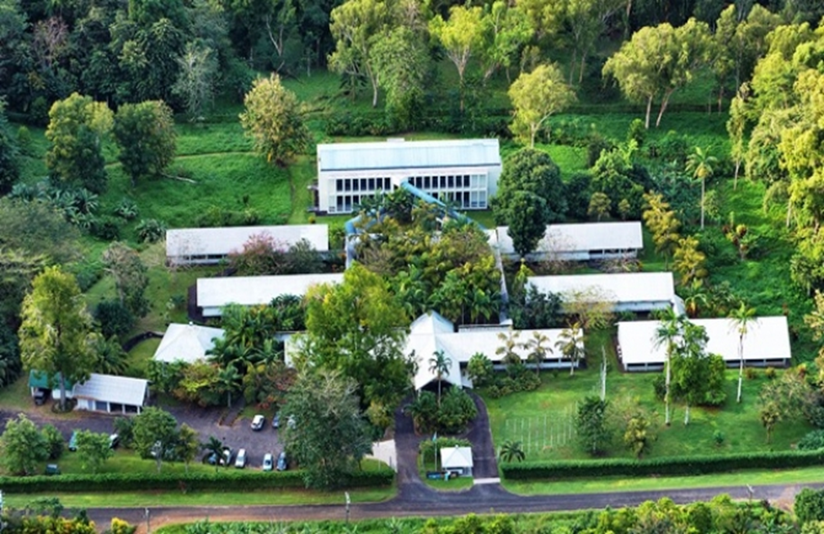
Secretariat of the Pacific Regional Environment Program(SPREP)

Slide 3
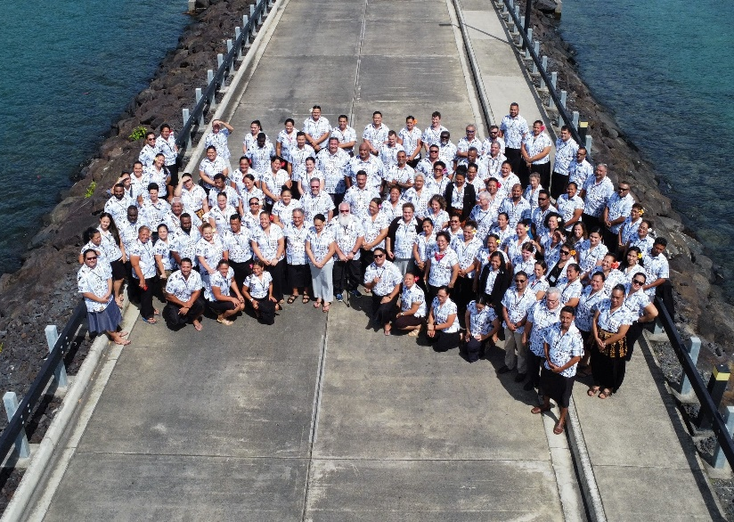
Mandate & Vision
Mandate
To promote cooperation and provided assistance to protect and improve its environment,
and to ensure sustainable development for present and future generations.
Vision
“A resilient Pacific environment, sustaining our livelihoods and natural heritage in harmony with our cultures”
Members
21 Pacific island member countries and territories
14 Pacific Island Countries. and 7 territories.

Slide 4
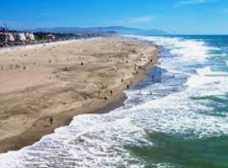
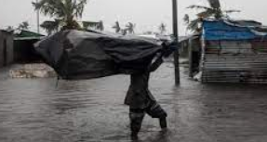
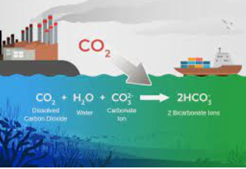
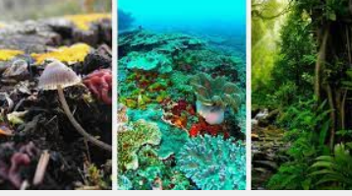
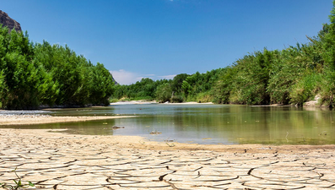
Challenges in Pacific Island Countries
Climate Change & Environmental Degradation
Rising sea level
Ocean acidification
Extreme weather events
Water scarcity
Loss of biodiversity
Food insecurity
Displacement/Relocation
Economic Impact

Slide 5
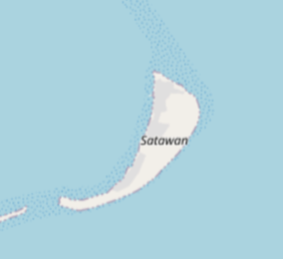
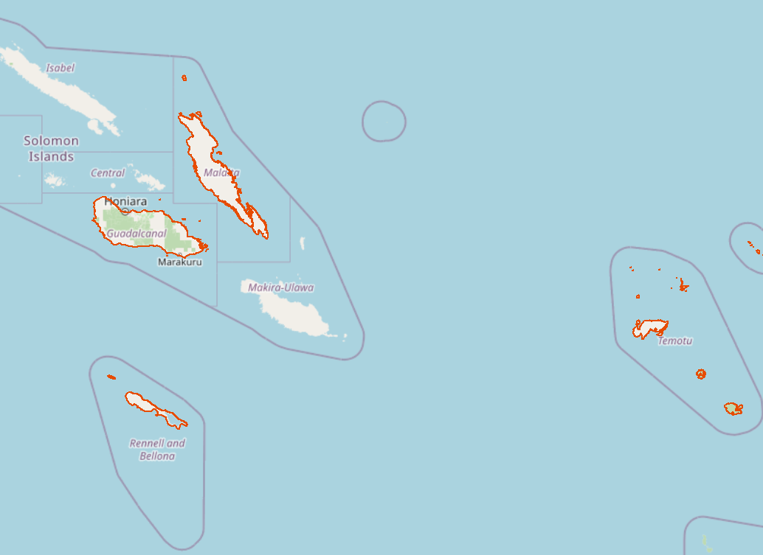
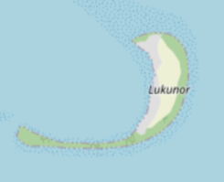
Subject Areas
Solomon Islands
Chuuk State in FSM

Slide 6
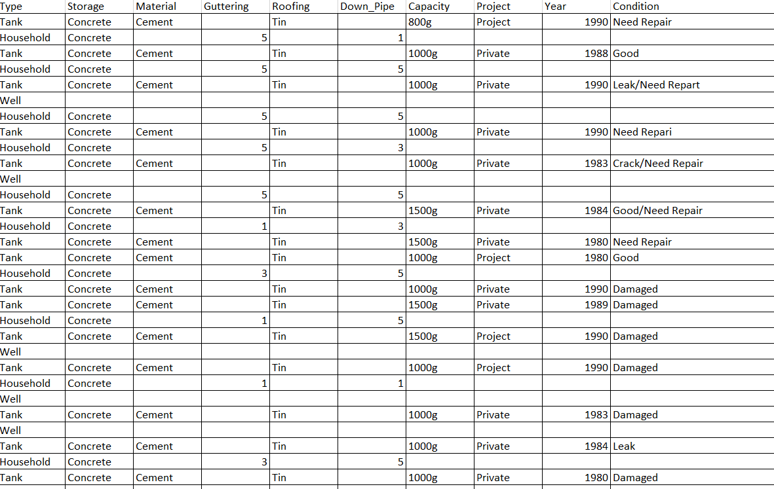
Water Infrastructure Mapping in FSM
Notes:
The case under the SUPA an AF projects. Able to locate and present data on the households water security systems
Tools for assessing water infrastructure
With the GIS tools it was possible to collect data on the quality and type of water infrastructure in order

Slide 7
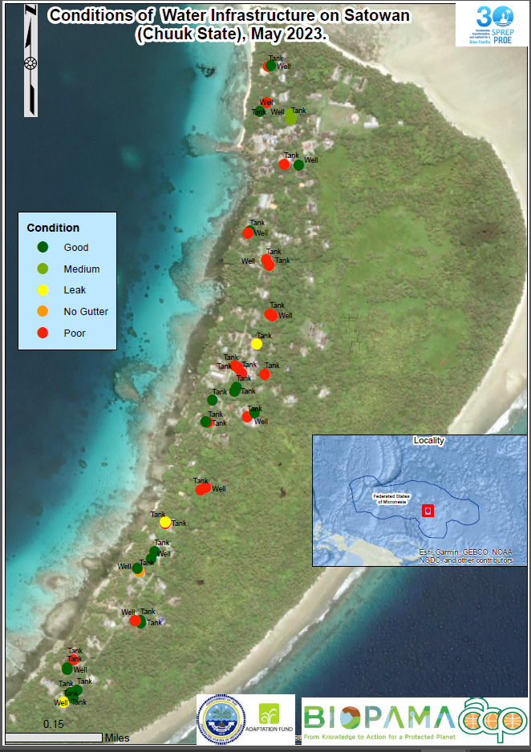
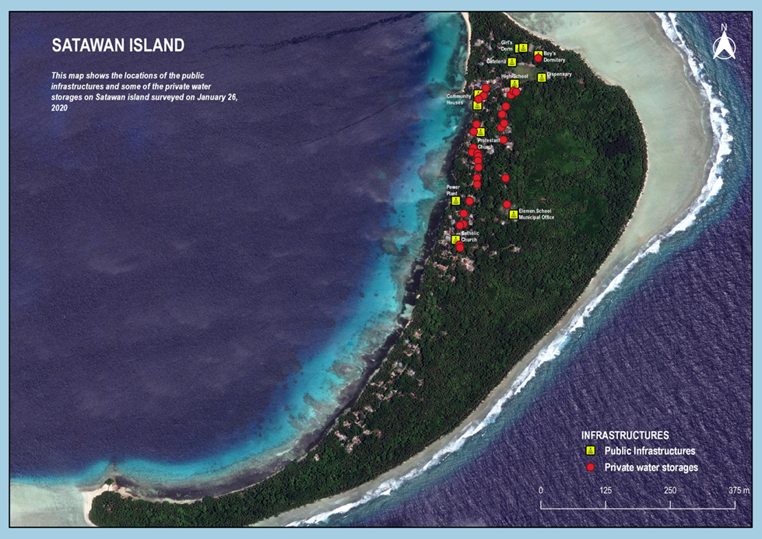
Water Infrastructure Mapping in FSM

Slide 8
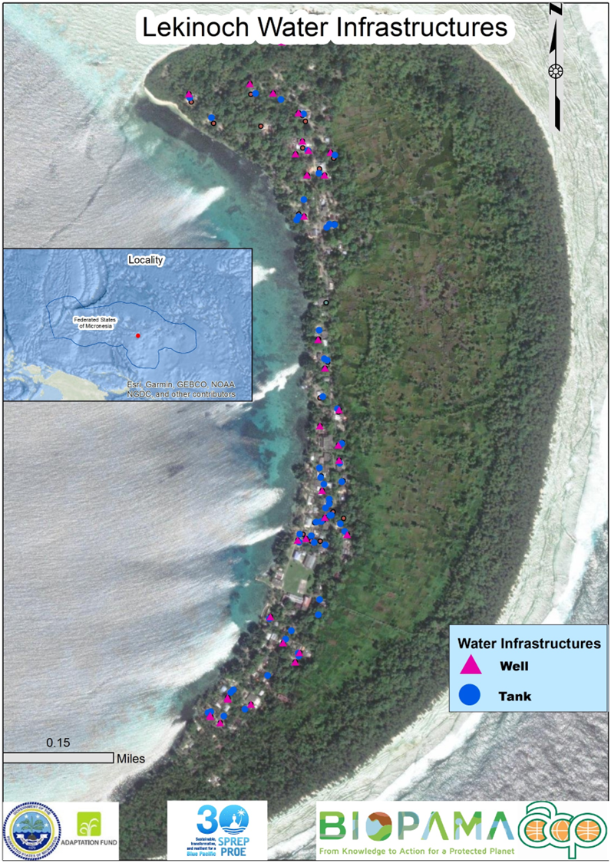
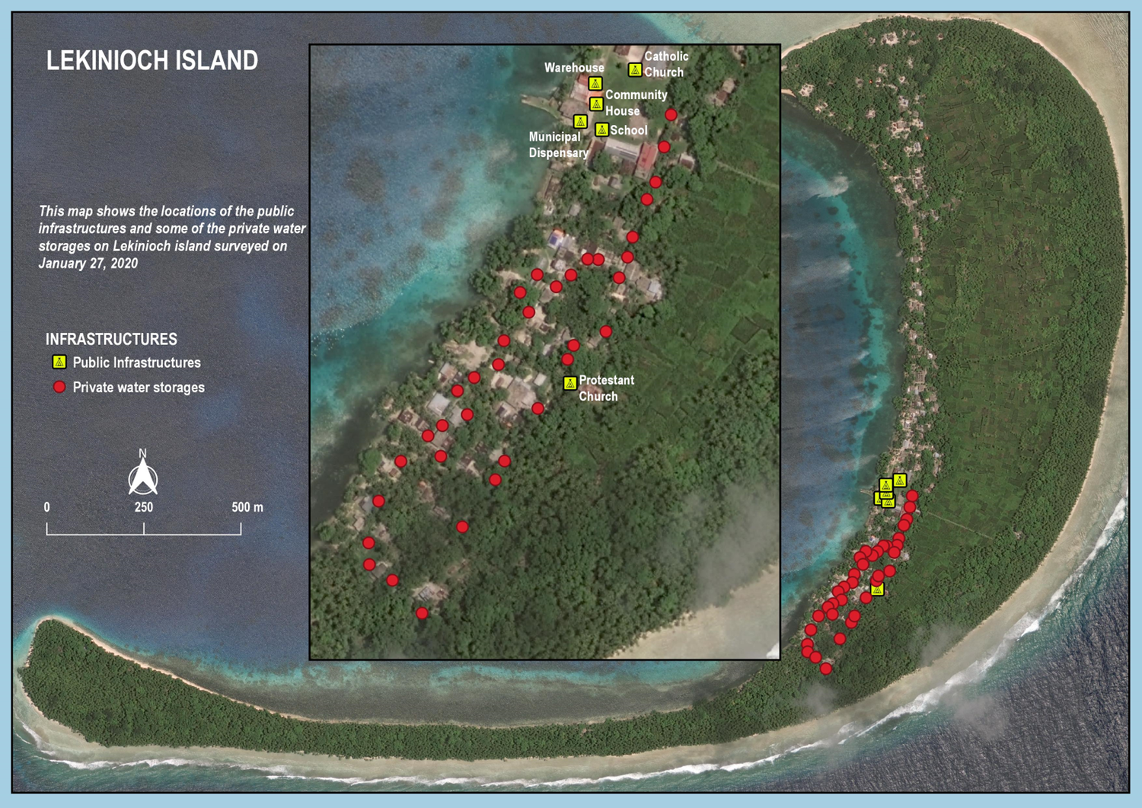
Water Infrastructure Mapping FSM Continue

Slide 9
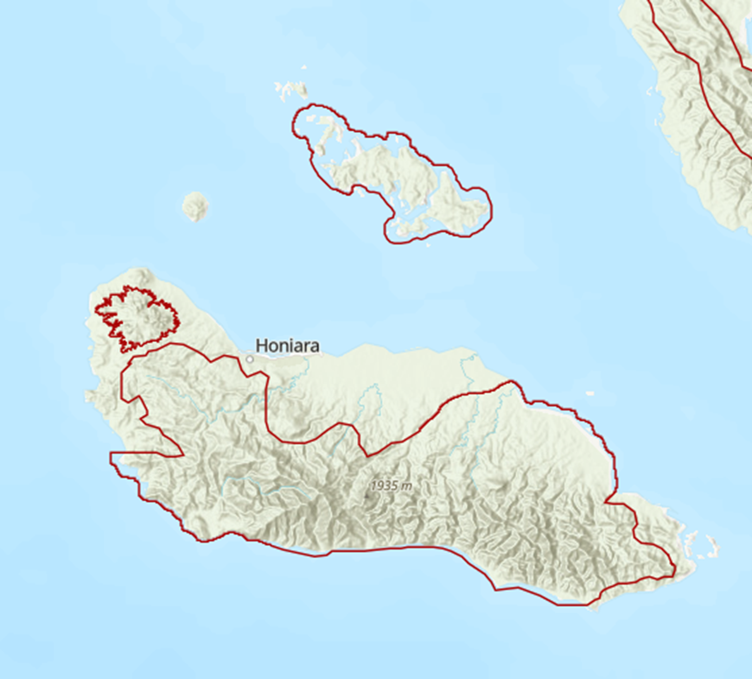
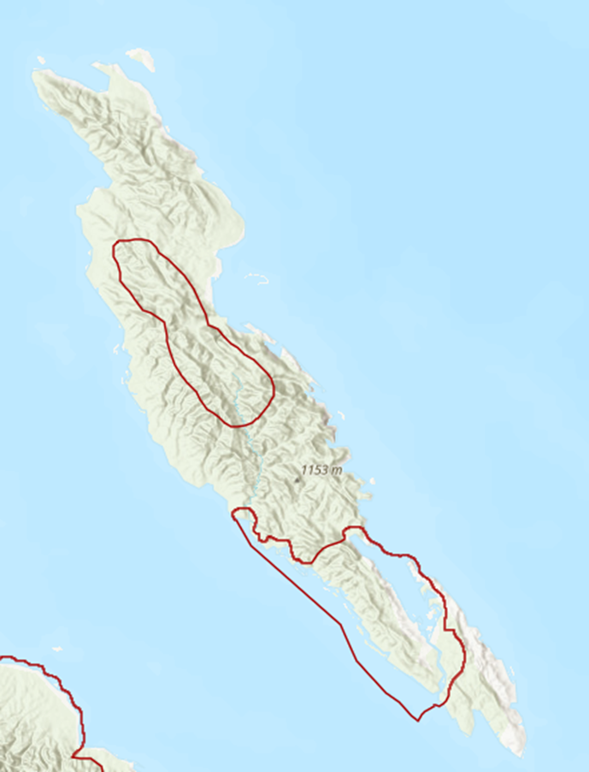
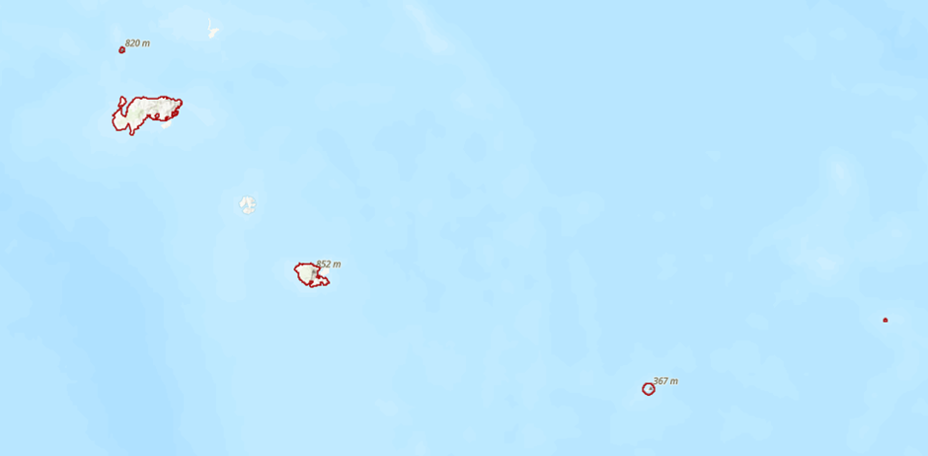
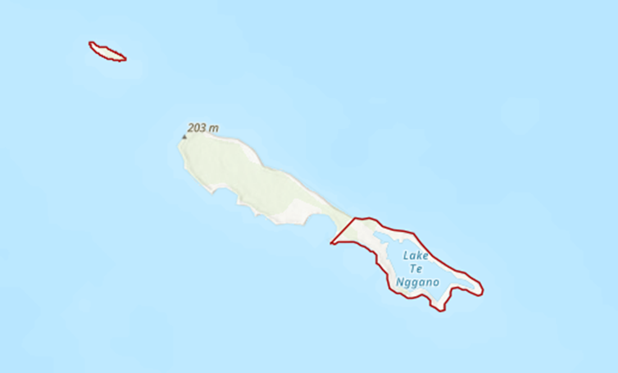
Protected Areas in Solomon Islands

Slide 10
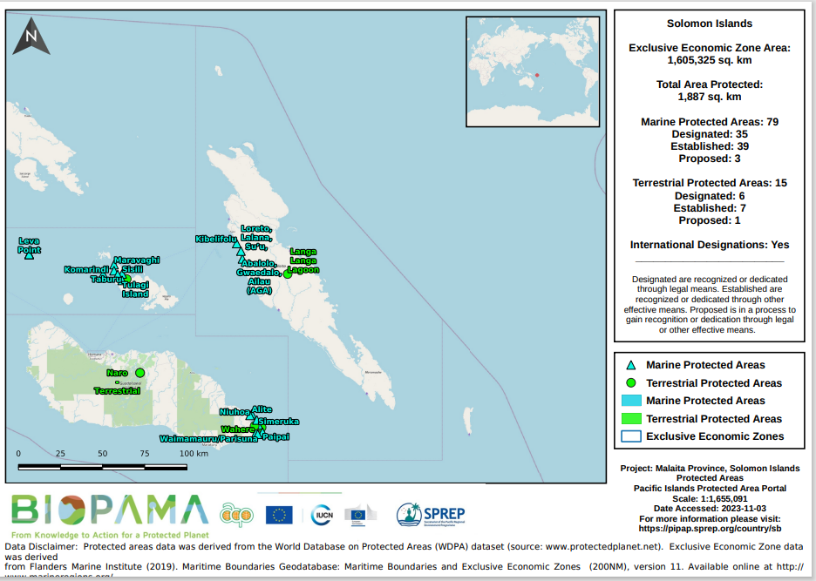
Protected Area in Solomon Islands

Slide 11
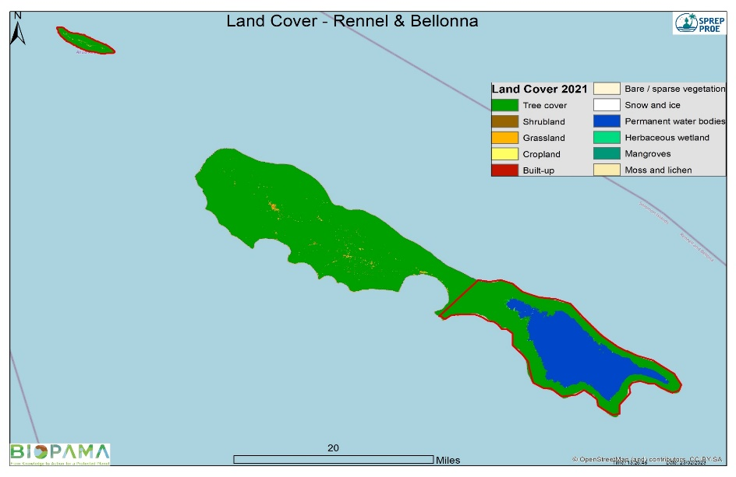
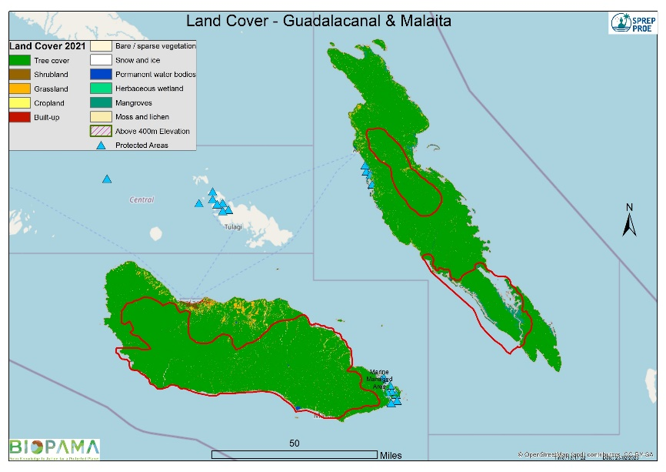
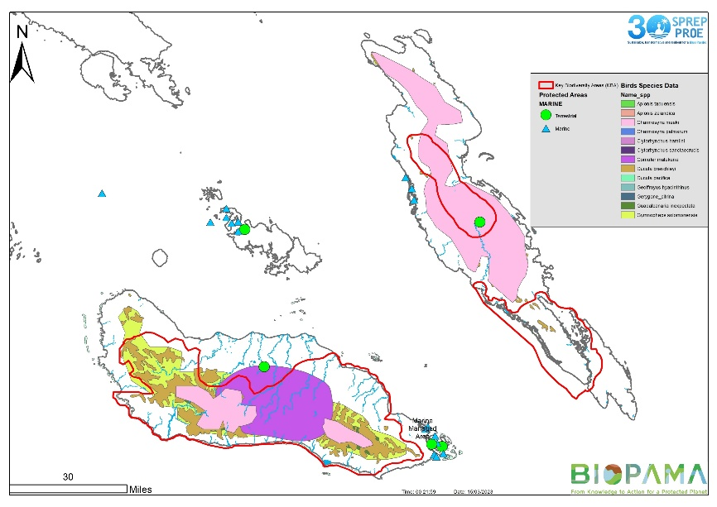
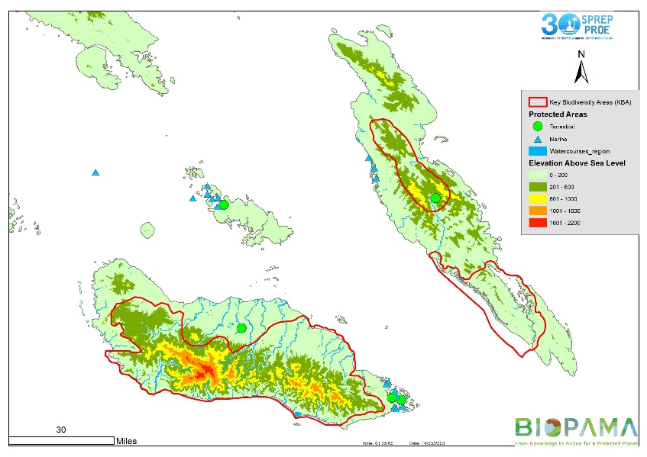
Protected Area in Solomon Islands

Slide 12
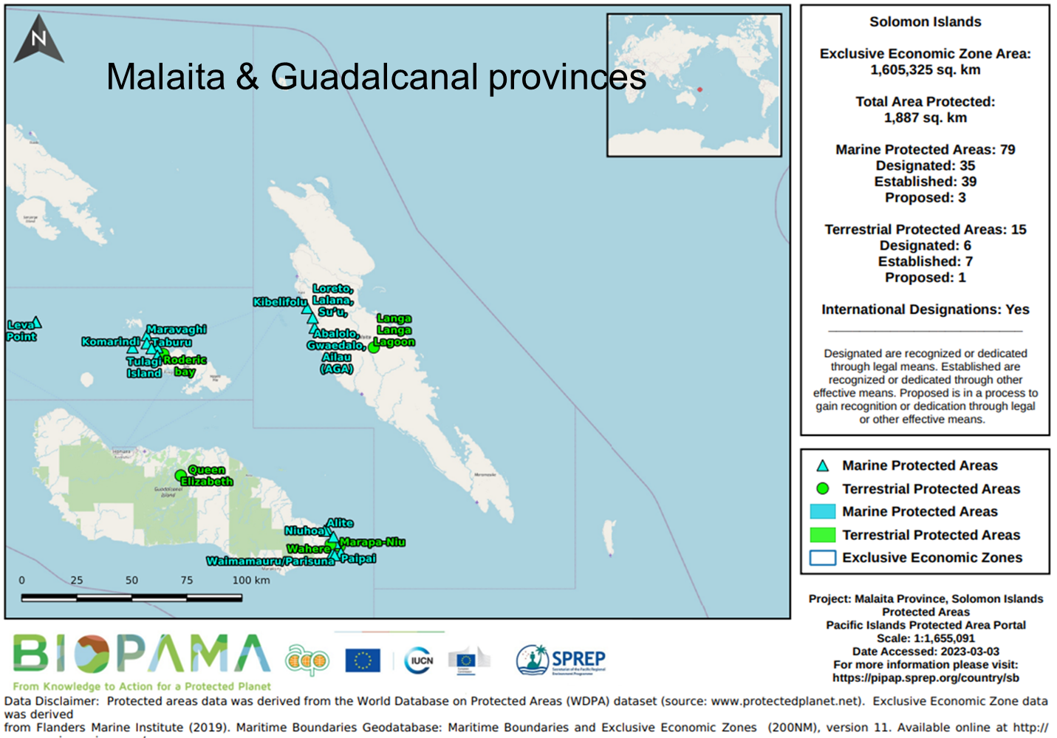
Summary of Current status of data analysis
Analysis from available data
Identified gaps particularly in Forest and land use.
Need local data to fill gaps.

Slide 13
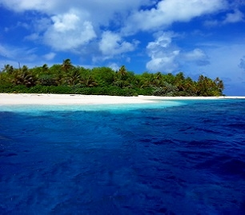
GIS E-Learning
Conclusions & discussion
Access to data
Collaboration with key partners
Technical Support and capacity development

Slide 14
Vinaka Vakalevu Fa’afetai! Thank You
kasaqat@sprep.org
vanik@sprep.org

