Slide 1
ERDAS IMAGINE
Live Link for Google Earth Engine
Pacific GIS & Remote Sensing Conference – Nov 2023
Angela Manchester
Angela.manchester@hexagon.com

Slide 2
Shared Mission Values
To Optimize Data Solutions at a world scale
Hexagon
“Putting data to work to enable autonomous, connected ecosystems that boost efficiency, productivity and quality...”
Google
“To organize the world’s information and make it more accessible and useful.”

Slide 3
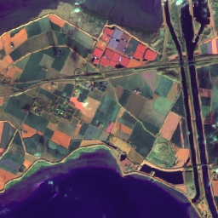
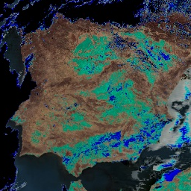
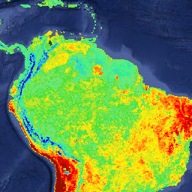
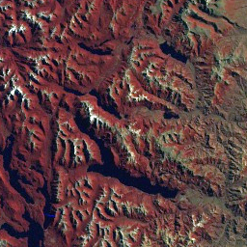
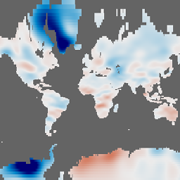
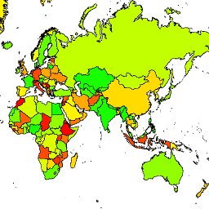
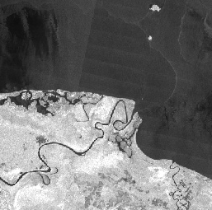
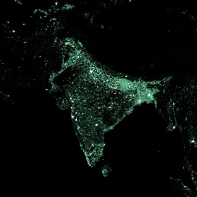
The Data Catalog
Climate and Weather Data Surface Temperature Climate Models Atmospheric Weather
Imagery Landsat Sentinel MODIS High-Resolution Imagery
Geophysical Terrain Land Cover Cropland Other Geophysical Data
Formats Imagery Vector
Information Source: https://developers.google.com/earth-engine/datasets/

Slide 4
50+ Petabytes
Growing daily

Slide 5
But why is it relevant?
Do you:
Need to assess risk
Monitor land use change
Improve operational decision making at a large scale
Enhance location-based apps
Manage natural resources
And do you need
Fast, Easy, Access to Petabytes of Satellite Imagery
And preferably with reduced Internal IT overhead?
5
| hexagon.com

Slide 6
Ok and What is The IMAGINE Live Link ?
It’s the Best of Both Worlds! Google + Hexagon
The combination of: THE DATA + THE GRAPHICAL USER INTERFACE
THE DATA: Google Earth Engine’s Data Catalog and operators
THE GRAPHICAL USER INTERFACE: Imagines spatial modeler and its drag and drop capabilities
Means users who would have required more extensive coding experience to use Google Earth Engine not only now obtains a more user interface, they also now have a total combined library of THOUSANDS of Spatial Operators
The only limitation is your Creativity.
6
| hexagon.com

Slide 7
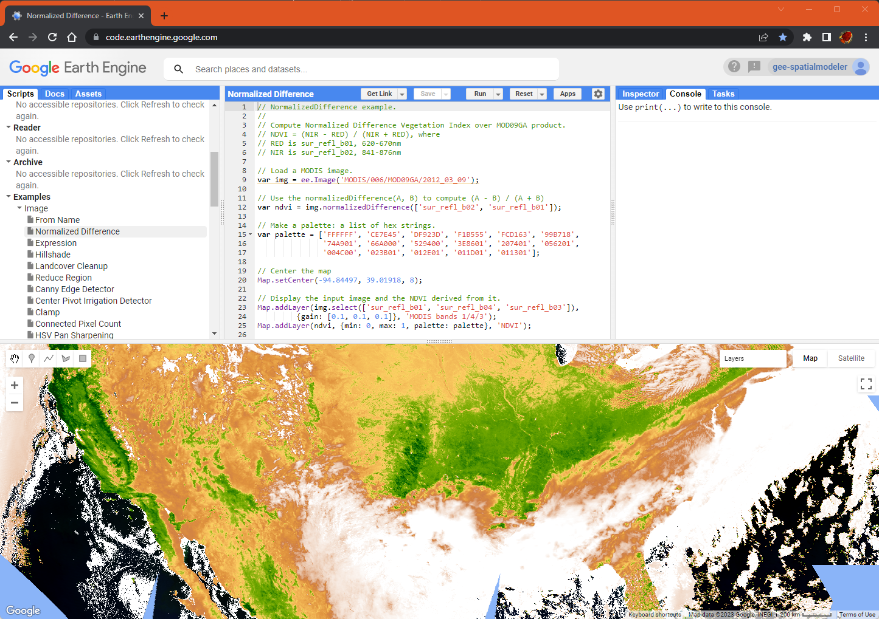
Google Earth Engine API
Over 800 processing functions operating on the cloud with the data
Functions include feature and image processing
Concept and structure is very similar to Spatial Modeler
API is available as JavaScript, Python or REST
JavaScript (pictured here) and Python are very easy to use and get started IF you are a programmer
A small number of geospatial workers are programmers
7
| hexagon.com

Slide 8
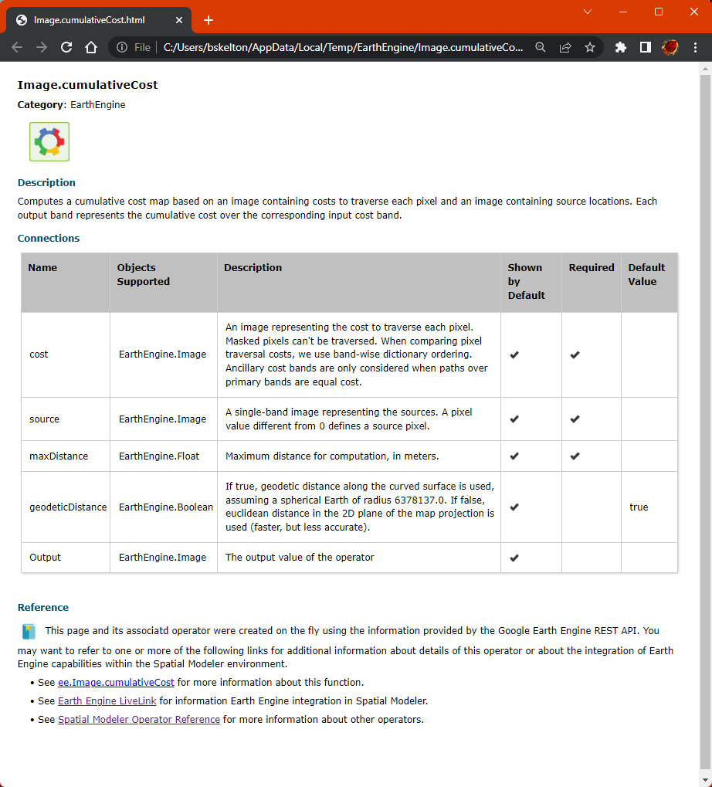
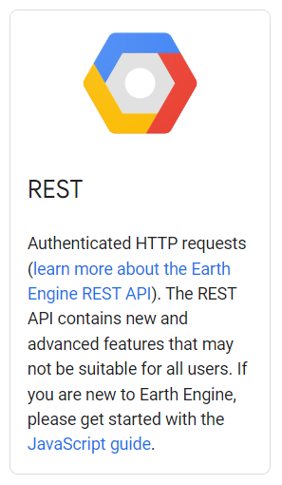
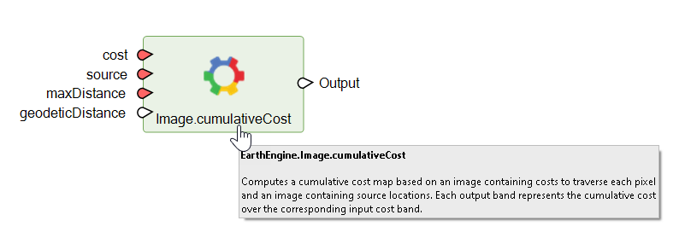
Linking to Earth Engine using the REST API
Provides access to all of the Earth Engine functions using HTTP/HTTPS protocols
Allows discovery of data in the catalog
Allows discovery of the available functions each of which is fully described as shown in the JSON snippet to the left
Which can be converted to a documented Spatial Modeler operator on the fly
Adds about 800 new operators to Spatial Modeler
{
"name": "algorithms/Image.cumulativeCost",
"description": "Computes a cumulative cost map based on an image containing costs to traverse each pixel and an image containing source locations.\nEach output band represents the cumulative cost over the corresponding input cost band.",
"returnType": "Image\u003cunknown bands\u003e",
"arguments": [
{
"argumentName": "cost",
"type": "Image\u003cunknown bands\u003e",
"description": "An image representing the cost to traverse each pixel. Masked pixels can't be traversed. When comparing pixel traversal costs, we use band-wise dictionary ordering. Ancillary cost bands are only considered when paths over primary bands are equal cost."
},
{
"argumentName": "source",
"type": "Image\u003cunknown bands\u003e",
"description": "A single-band image representing the sources. A pixel value different from 0 defines a source pixel."
},
{
"argumentName": "maxDistance",
"type": "Float",
"description": "Maximum distance for computation, in meters."
},
{
"argumentName": "geodeticDistance",
"type": "Boolean",
"description": "If true, geodetic distance along the curved surface is used, assuming a spherical Earth of radius 6378137.0. If false, euclidean distance in the 2D plane of the map projection is used (faster, but less accurate).",
"optional": true,
"defaultValue": true
}
]
}
8
| hexagon.com

Slide 9
Working Example: NDVI Indices by Boundary Polygon for Feature Analysis
The following demo will;
1. Obtain a satellite image from google (not local storage)
2. Perform band selections and band ratio to create an NDVI index image
3. Create Feature Statistics of average NDVI value per Polygon from a locally saved vector file
4. Display dynamically on screen. Again with no dataset output required
5. Output a local vector file of the result
This gives you actionable data from satellite imagery in a business ready and digestible format.
9
| hexagon.com

Slide 10
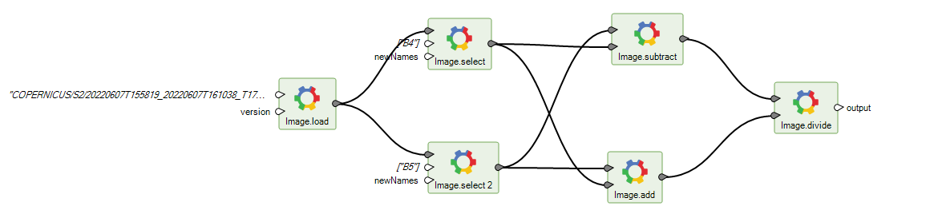
An Earth Engine expression
A connected series of Earth Engine operators forms an Earth Engine expression
Expressions are inputs to the EARTH ENGINE REST API
10
| hexagon.com

Slide 11
Use two edge operators to complete the model
Add the Load Earth Engine Image and Compute Raster operators to make a functional model
11
| hexagon.com

Slide 12
Run the NDVI calculation
12
| hexagon.com

Slide 13
Ease of Use: Copy/paste from Google Earth Engine catalog
Copy a dataset reference from the Catalog
Paste it into the model
Connect it and run
13
| hexagon.com

Slide 14
Combine data on the cloud with local data
The NDVI section executes on the cloud
The feature statistics section executes locally
Results are persisted to a feature dataset
14
| hexagon.com

Slide 15
The combined results: RAPID Data Analysis
15
| hexagon.com

Slide 16
Achieve scalability through map and reduce
Mapping feeds each of its collections of items through a given “algorithm” and produces an output collection which contains each of the processed items
Reducing uses a defined reducer to combine the inputs in some fashion to produce a single output item
Mapping can be massively scaled on the Google cloud infrastructure to bring many concurrent processing nodes to the problem
Map
Reduce
Algorithm
16
| hexagon.com

Slide 17
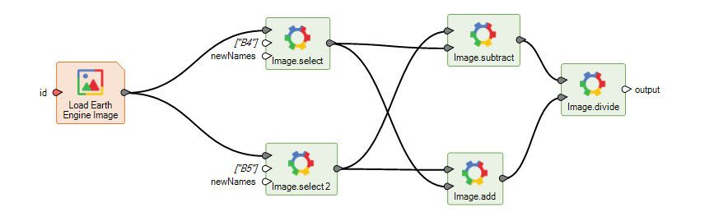
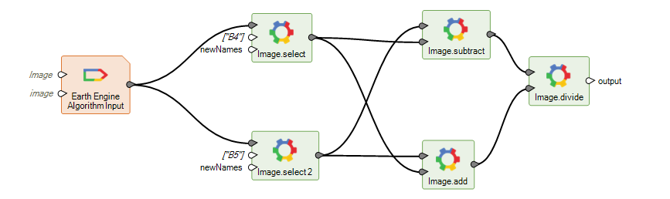
Create an algorithm from an expression
An Earth Engine algorithm
Start with an expression
Replace the input with the Earth Engine Algorithm Input operator
This defines the types and names of the inputs to the algorithm
17
| hexagon.com

Slide 18
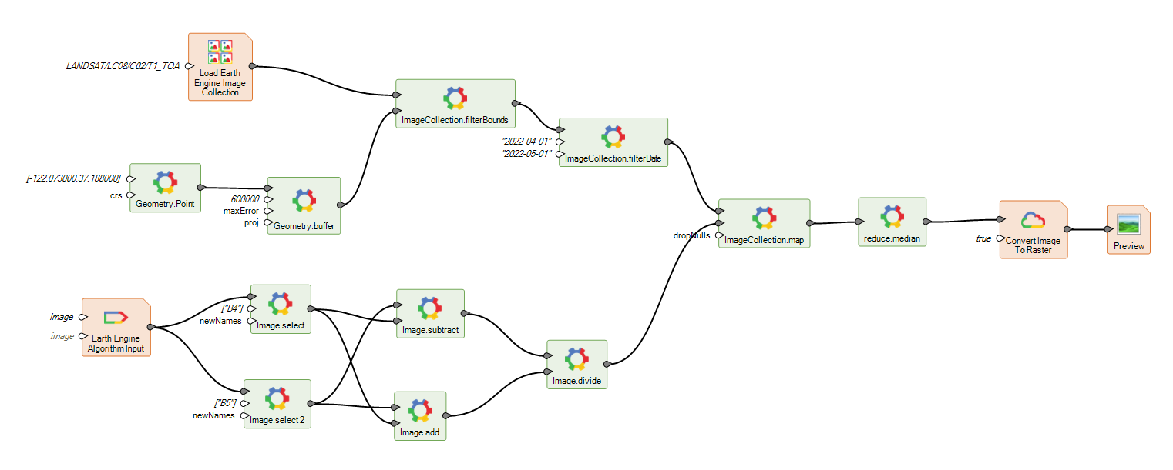
A map reduce example
sdfgsdfg
The collection
Map and reduce
The algorithm
18
| hexagon.com

Slide 19
Mapping at Large Scale: Map reduce results
19
| hexagon.com

Slide 20
Batch execution
Tasks are submitted to the batch queue and will be processed in the order submitted. These run at a lower priority than the on-demand execution and are charged at a lower rate.
Use this for production runs. Use the on-demand for quick development turnaround.
Use the Wait For Completion operator to wait till done
Export type | Description | To asset | To Google Cloud | To drive
Export Image | Evaluates the image expression and saves it to a named image at the destination location
Export Video | Evaluates the ImageCollection expression and saves it to named location as a video
20
| hexagon.com

Slide 21
ERDAS IMAGINE LiveLink for Google Earth Engine deployment
The LiveLink extension is built into the 16.8 SMSDK
A LiveLink FNO feature code will be required to get access to the operators
An Earth Engine subscription private key will be required to connect to Earth Engine and run models.
21
| hexagon.com

Slide 22
LiveLink and Google Earth Engine
What can it provide?
Leverage massive content (Petabytes not stored on your infrastructure)
Leverage cloud computing (reducing need for High Spec Machines)
Stay in the trusted IMAGINE user environment
No need to build your environment in Google Earth Engine
Leverage IMAGINES drag and drop design
Optimise Data Access
Speed up processing and analysis
Reduce work effort and overheads as a result
22
| hexagon.com

Slide 23
Questions?
Angela.Manchester@hexagon.com

