Slide 1
27/11/2023 | Suva, Fiji
Trimble GIS Data Collection & RTX corrections

Slide 2
Introduction
Name: Hamish Clarke
Role: Account Manager
Location: New Zealand
Allterra: 2 years
Background: 12 years in Construction and Surveying industry
Notes:
I am here today to speak about the Trimble GIS portfolio covering hardware and software that can improve the data you collect and how you manage it. I will also speak about the RTX corrections hub that offers high accuracy GNSS data on a selection of GNSS product and how it can improve GIS data collection.
Introduce yourself with background in surveying and the construction industry. 4 years after the Christchurch earthquakes working as a surveyor over a variety of work. In this role I undertook topographical surveying work, monitor, multi-level construction set-out as well as asset collection and management. Since late 2021 I have been working as an account manager with Allterra covering geospatial, GIS and construction technology.

Slide 3
Company Background
GeoSystems was established in 1985,
transformed into ALLTERRA, SITECH and BuildingPoint in 2014
ALLTERRA, SITECH and BuildingPoint are the global brands for the network of Trimble distribution partners providing technology into the AEC industry
Notes:
Allterra (formally geosystems) is the Trimble dealer for New Zealand and the Pacific Islands. With in New Zealand our company is made up of three parts, Allterra covers Survey and mapping, Sitech covers earthmoving and civil construction and Buildingpoint covers high rise construction.
AEC stands for Agriculture, Engineering, and Construction

Slide 4
The Companies
Largest Trimble distributor in the world is in Australia
Purchased the NZ group in 2015
We are now 300+ people across ANZ
Includes TBC development resources
Trimble employs 500+ people in NZ across 8 locations
Developed in NZ : Trimble Access & Trimble TerraFlex
NZ offices contribute to all of Trimble’s core technologies
NZ surveyors are across the global Trimble organisation (e.g. VP of Surveying & Mapping is from Christchurch)
Notes:
Alterra is part of a wider group of companies that fall under the umbrella of UPG Ultimate position group out of Australia. UPG is the largest Trimble distributor in the world and covers the majority of the Trimble hardware and software portfolio.
Trimble, has over 12000 staff worldwide, with the office in Christchurch being the fourth largest. Two key data collection software packages, Trimble Access, and Terraflex are developed in Christchurch, as well as a selection of the GIS and GNSS hardware.

Slide 5
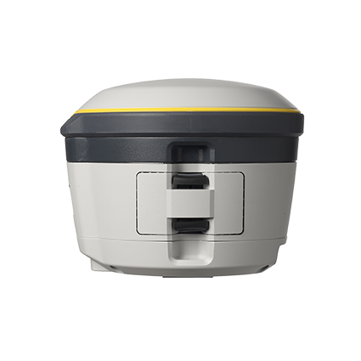
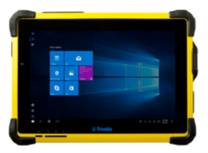
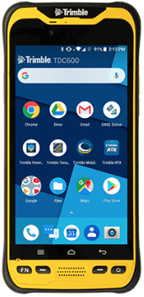
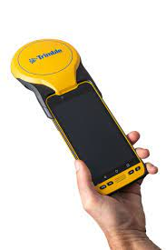
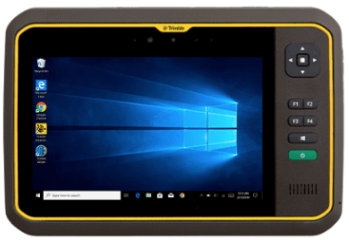
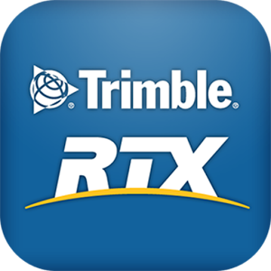
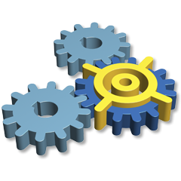
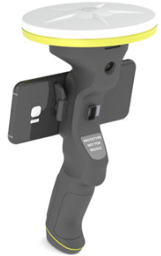
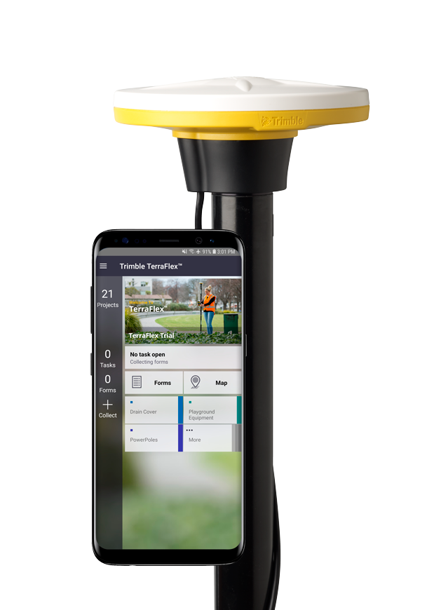
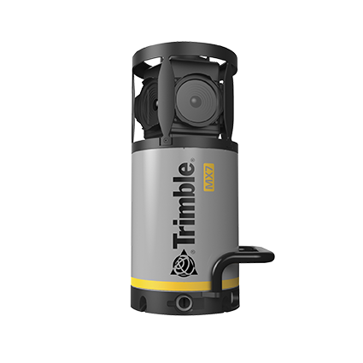
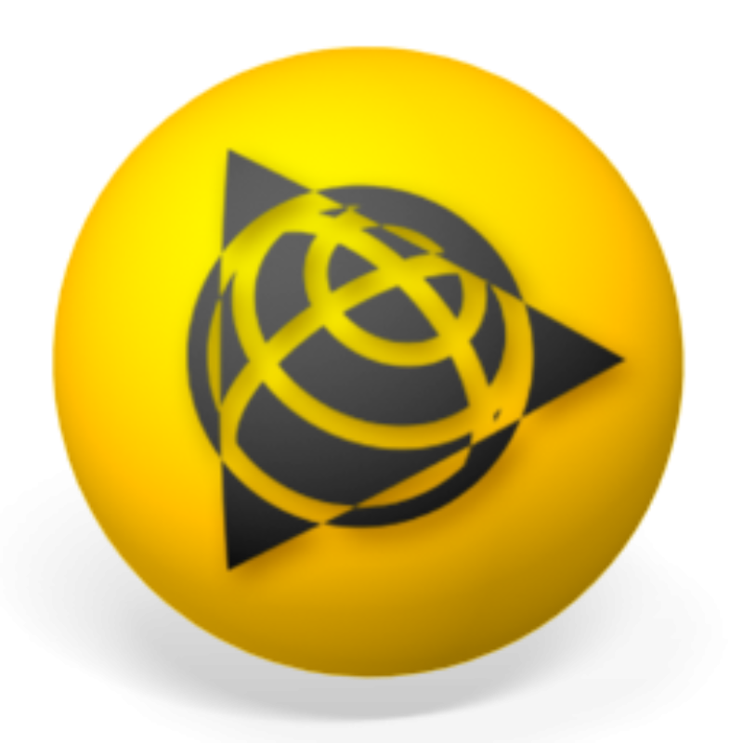
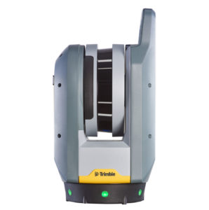
Trimble GIS Overview
Modular GNSS Systems
Mobile Devices & Tablets
Mobile & Cloud GIS Software
Correction Services
Augmented Reality
Integration SW & SDKs
Office SW
TBC GIS
Trimble
Catalyst
Mobile
Mapping
Scanning
Notes:
The Trimble GIS portfolio covers a wide range of products. From integrated and modular GNSS receivers, working with a wide range of mobile devices and tablets, using cloud based software packages for the collection, processing, and management of your data. Together they create a customizable all-in-one workflow package to suit your business requirements.
We also have augmented reality, stationary and mobile scanners as well as a selection of office software for processing of the collected data.

Slide 6
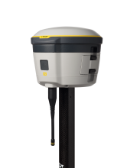
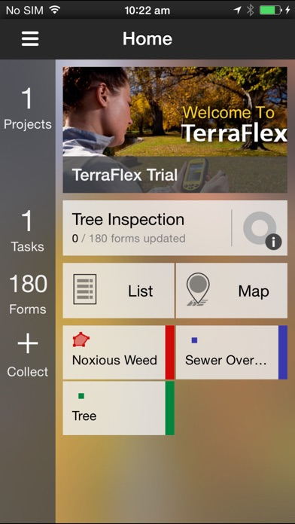
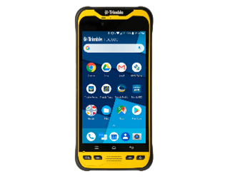
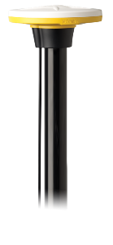
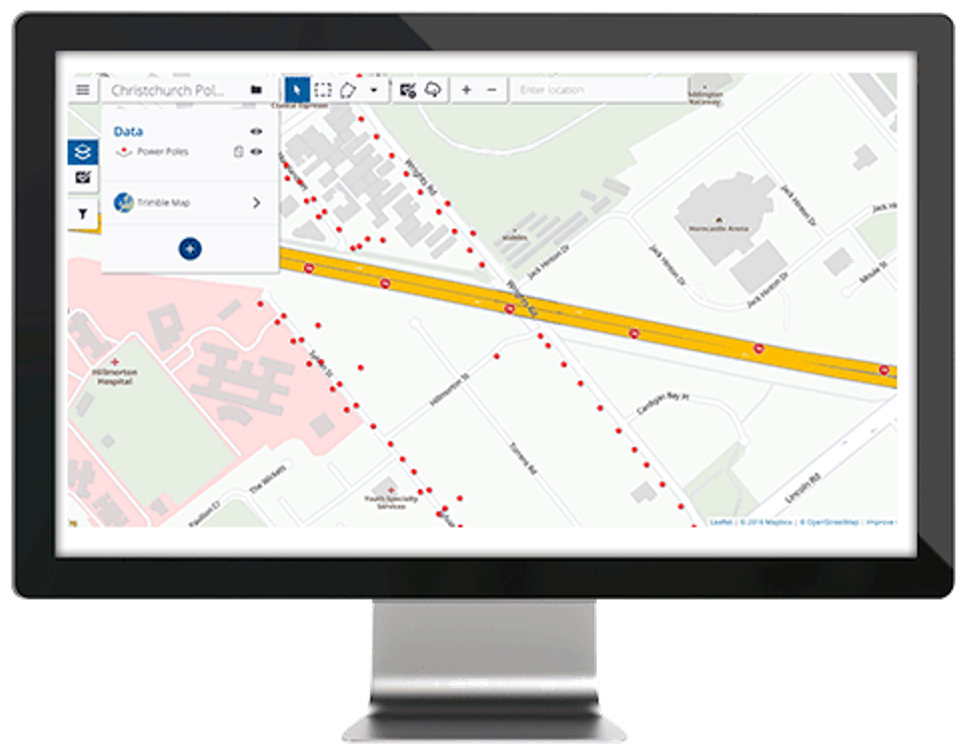
Trimble Mobile GIS Data Collection
Handheld
Software
GNSS
Delivery
+
+
+
Select your preferred Trimble mobile device (or BYOD)
Trimble TerraFlex for GIS data collection and maintenance
Improve the spatial accuracy of your data by pairing with GNSS
QA/QC your data and send to your GIS or CAD system
Notes:
The Trimble GIS portfolio offers a start to finish package.
Select your device handheld device, this could be the TDC600 seen here, or could be a TDC650 with integrated GNSS receiver.
Choose a field software package, here we have Trimble Terraflex, this can be run on android and iOS devices so isn’t limited to Trimble devices. Third-party software is also compatible with our handhelds.
If high accuracy GNSS data is required add an external GNSS receiver such as the DA2 or R2. These allow for additional satellite constellations to be tracked, as well as post-processing of data
And after you have finished collecting your data with Terraflex you can view it within Trimble Connect a cloud server that multiple users can access to collaborate

Slide 7
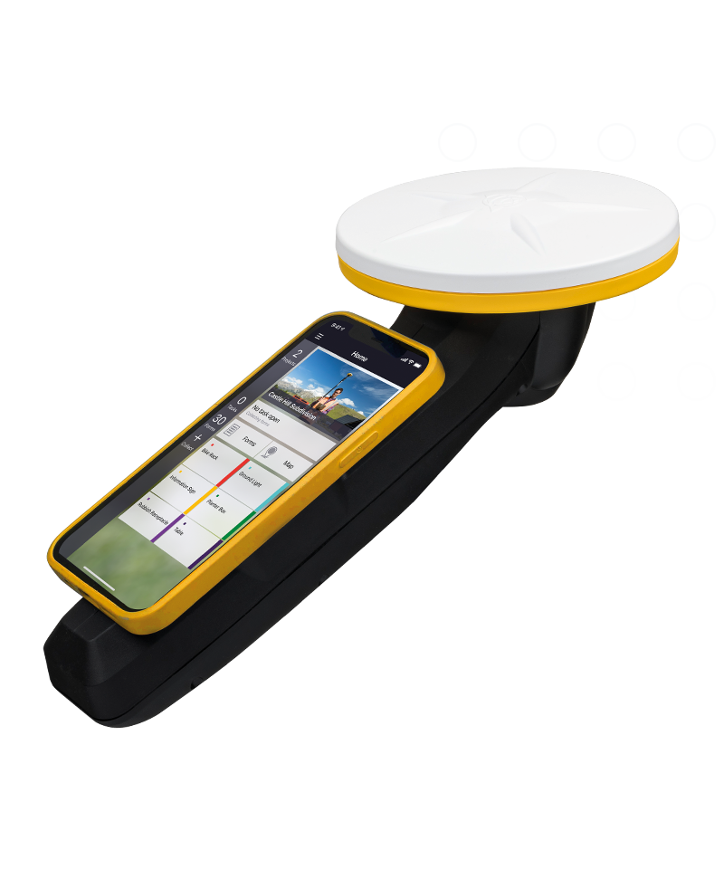
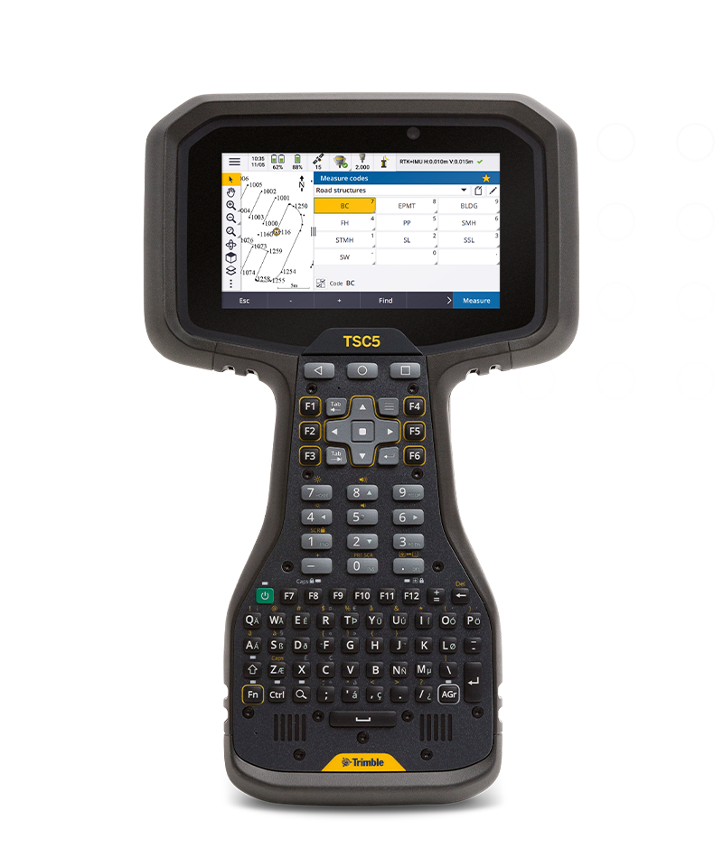
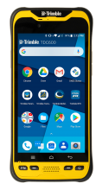
Trimble Handhelds
Name
TDC600
TDC600 + DA2
TDC650
TSC5
Display
6.0 inch
6.0 inch
6.0 inch
5.0 inch
OS
Android 8.0
Android 8.0
Android 8.0
Android 8.0
Location
1.5 m (SBAS)
1-60 cm RTX
2-50cm RTX
2-5m
GNSS
Internal U-blox
Modular
Integrated
Internal U-blox
Notes:
Here is a selection of the most commonly used data collectors in the portfolio.
The TDC600 is a rugged device that can run as a standalone or pair it with the Catalyst DA2 antenna for higher accuracy work. It runs on an android operating system which offers flexibility for data collection applications. The full Trimble data collection suite can run on it, as well as third party applications such as the Esri suite
The TDC650 is an all-in-one rugged handheld data collector incorporating an android device with a GNSS receiver. These units are ideal for asset management Like the TDC600 it runs on android.
The TSC5 is another android device that can be paired with GNSS receivers like the Catalyst DA2 and R2. It can also be paired with a barcode reader for asset management.
If you are looking for accuracies under 30cm a GNSS receiver on a pole is the best option

Slide 8
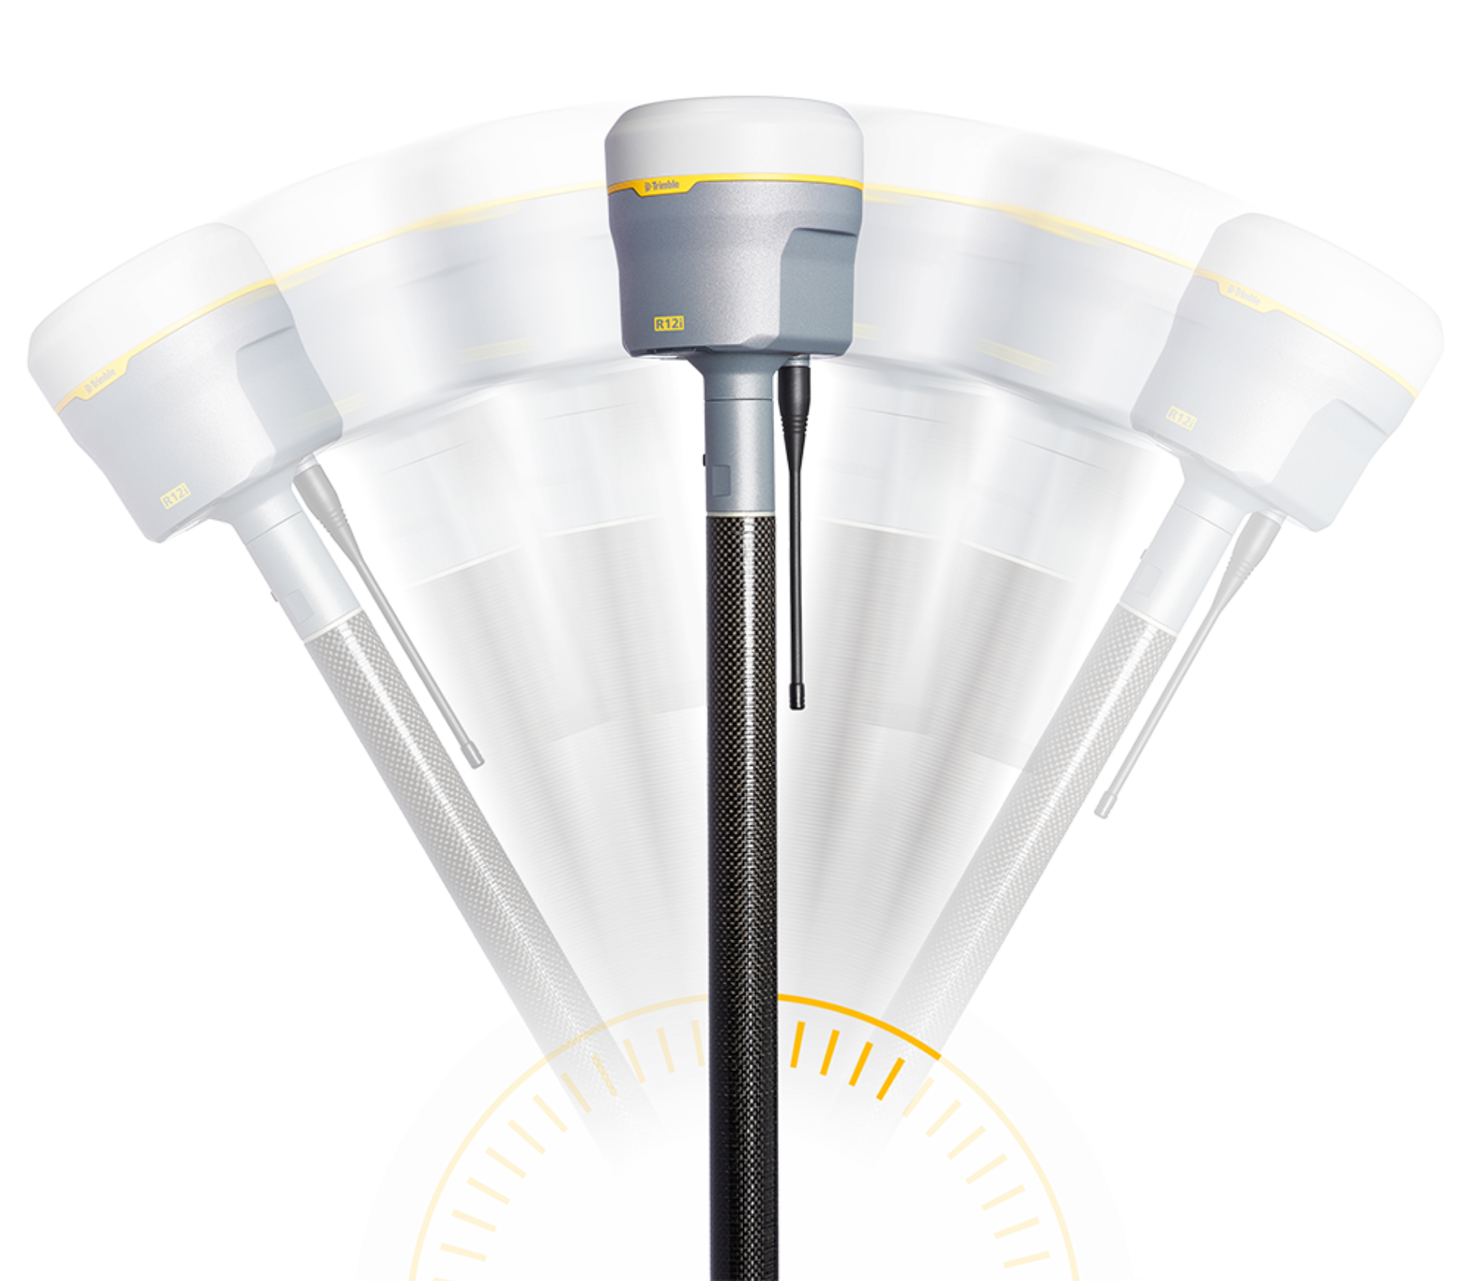
Trimble GNSS
Trimble R12i
2cm – 50cm
RTX corrections
Catalyst
2cm - 100cm
RTX corrections
Trimble R2
2cm - 50cm
RTX corrections
Notes:
These are the main GNSS receiver’s used in the GIS sector. As stated before the Catalyst DA2, R2 and on the right we have the R12i. This unit features an IMU which allows you to not have to plumb the pole when collecting data. This function is useful when surveying coral reefs or hard to get to locations.

Slide 9
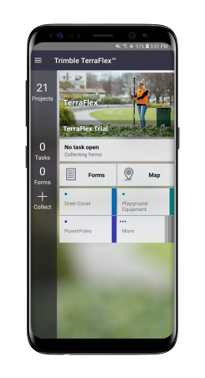
Software: Trimble TerraFlex
Mobile app for fast & efficient feature capture
Collect new data or take data already in your GIS to the field for updates
Online workflow that leverages the cloud for data synchronising and real-time GNSS corrections
Offline & post-processing workflows
Designed for Windows, Android & iOS devices
Integrate with laser rangefinders
Notes:
Terraflex is GIS specific data collection software Trimble has developed. Projects are created via Trimble Connect then synchronized to Terraflex on your smartphone or tablet. Data is then collected in the field, and once you have completed your work you can sync the data back to Trimble Connect and anyone who is in the project can view and export the data. Multiple users can work with-in a project for collaborative data collection.

Slide 10
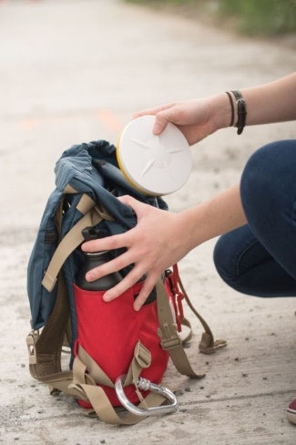
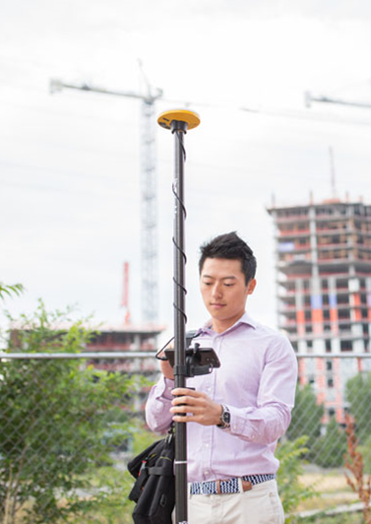
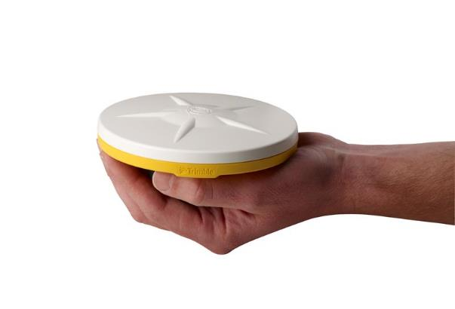
Trimble Catalyst
New type of GNSS solution from Trimble
GNSS positioning “as a service”(reduce the risk of adopting GNSS technology)
GNSS accuracy available on-demand for any location-enabled Android or iOS app
Works both while connected or offline through RTX corrections
What do you need to get started?
Trimble DA2 antenna
Android or iOS device (& location-enabled app)
Catalyst subscription
Notes:
The catalyst DA2 is the latest GNSS hardware for the GIS and survey sector. With configurable subscriptions the DA2 gives users the flexibility to collect data at the accuracies they desire. These units do not have to be paired with a Trimble specific device, they connect via Bluetooth and can pair to android and iOS devices running Trimble data collection software as well as some third-party software. Adding the DA2 to a smartphone or tablet is a cost-effective way to gain high accuracy data with a variety of field software options. It can also be paired with our main survey software Trimble Access

Slide 11
Licensing Options
60 cm
In optimal conditions.
Corrections via RTX
Monthly or annual unlimited use
30 cm
In optimal conditions.
Corrections via RTX
Monthly or annual unlimited use
10 cm
In optimal conditions.
Corrections via RTX
or a Local Source
Monthly or annual unlimited use
1-2 cm
In optimal conditions.
Corrections via RTX
or a Local Source
Monthly or annual unlimited use
1-2 cm
In optimal conditions.
Corrections via RTX
or a Local Source
Pay per hour
Catalyst 60
Catalyst 30
Catalyst 10
Catalyst 1
Catalyst 1 On Demand
*Paid subscriptions enable the Catalyst corrections engine, and bundle corrections from the Trimble Corrections Hub. Catalyst Freemium allows the Catalyst receiver to operate in Autonomous mode only.
Notes:
The DA2 operates on a subscription model. Here we have the accuracy options for the catalyst system. This has been designed to give user's flexibility with data collection. Ranging from 60cm – 1cm these can be purchased as monthly or annual subscriptions. We also offer on demand packages which can be shared and used by multiple people with-in your organisation. On demand subscriptions can be paired with monthly or annual subscriptions.
These accuracies are commonly achieved via mobile data corrections from a virtual base network. If you are in a location where there is no virtual base network we also have the option of accuracy corrections via the RTX correction hub

Slide 12
Notes:
In the past to achieve high accuracy GNSS data you would have to use a stationary base station which would log data, and then an additional GNSS receiver would communicate with this via radio. From there the data would need to be post-processed in an office software package. With the Trimble RTX correction hub you can now achieve high accuracy GNSS data without the need for additional equipment.

Slide 13
Trimble RTX Corrections

Slide 14
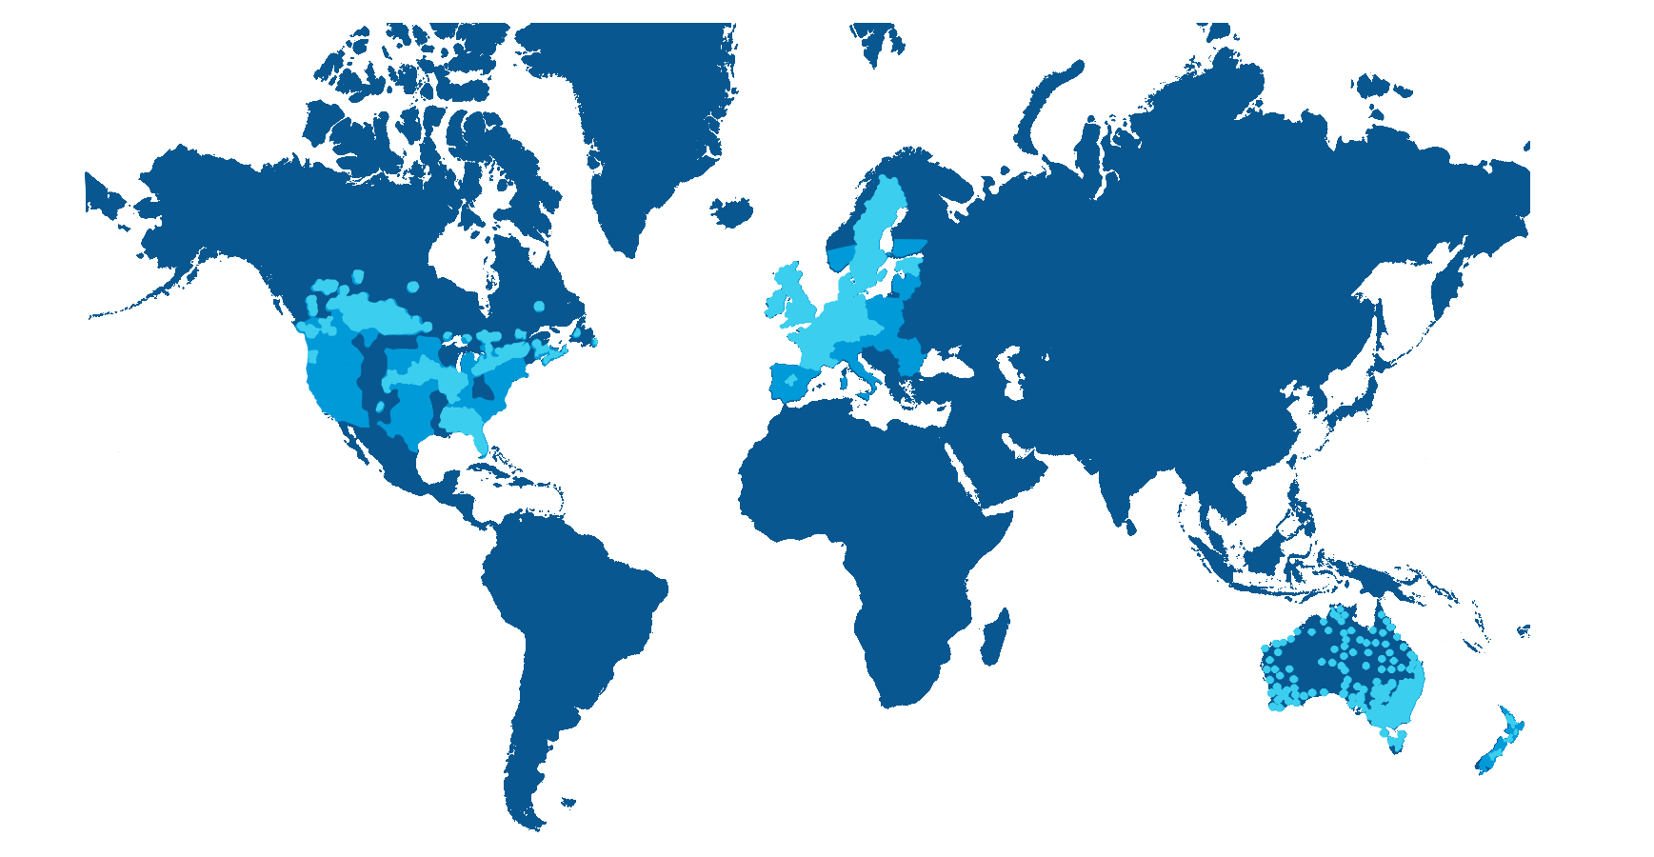
Trimble Corrections Hub
Notes:
It’s hard to see due to the coverage but I have been able to test the RTX correction hub in Suva this year, as well as last year. I was able to achieve CM level accuracy in both horizontal and vertical when using the Catalyst DA2 receiver. RTX subscriptions are can be applied to a range of GNSS receivers such as the TDC650, R2, and R12 range.

Slide 15
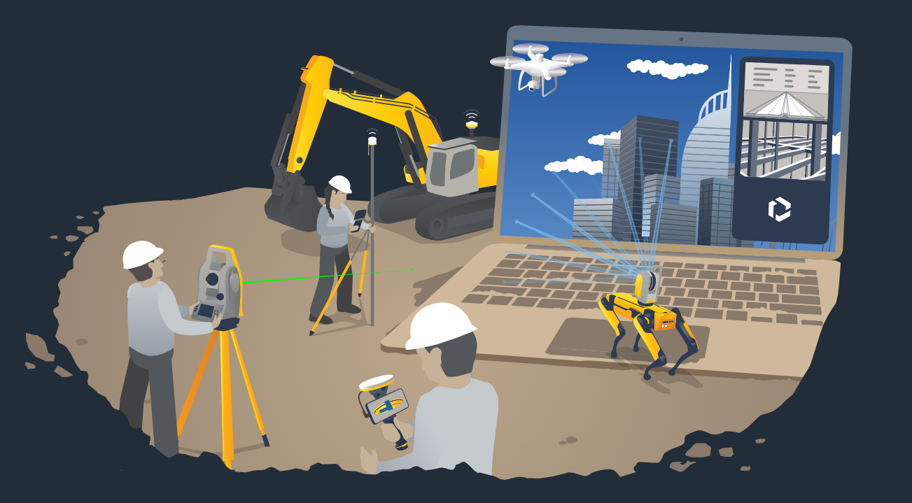
Thank You!
Notes:
Thank you for your time today, if you have any questions or would like to discuss more about the products I have spoken about I will be around until the end of the conference.

Slide 16
Thank You!
Hamish Clarke
hamish_clarke@allterra.co.nz
+6421909677
Notes:
Thank you for your time. If you have any questions or would like to discuss more about the technology I have covered I will be around for the remained of the week.

