Slide 1
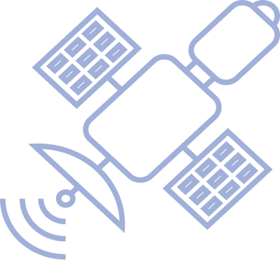
Copernicus assisting the Pacific
Copernicus services use case scenario
Thibault VALENTIN
thibault.valentin@ec.europa.eu
Programme Officer
Science, Technology, Innnovation, Digitalisation
DG INTPA – European Commission

Slide 2
The EU Space Programme.

Slide 3
Copernicus.
To add a picture, please move the grid elements on the side and then place back.
Copernicus is the Earth Observation component of the European Space Programme and a flagship of the EU Space Policy.
It delivers data, information and services based on satellite data and in situ data on the state of our planet and its environment for the benefit of society.

Slide 4
6 services use Earth Observation data to deliver…
Contributing missions
Sentinels
30 dedicated satellites by 2030
FULL, FREE AND OPEN DATA POLICY
…added-value products available through Five cloud-based platforms
Notes:
Copernicus was born as a tool for environment monitoring and as the EU’s contribution to global environment and climate change efforts (including international commitments such as COP21)

Slide 5
Copernicus Services.
Satellite data and in situ data are turned into timely and actionable information by processing and analysing it.
Statistical information and maps are derived from imagery, features and identified anomalies.
Trends and historical evolutions are determined through datasets stretching back for years and decades.
These value-added products are streamlined through six thematic streams of Copernicus services:

Slide 6
Benefits of Copernicus.
To add text and pictures, please move the grid elements on the side and then place back.
The data generated are used by service providers, public authorities and international organisations to :
support the management of the environment,
mitigate the effects of climate change,
ensure safety and civil security.
Instructions can be extracted from this accurate geoinformation. They have a wide array of applications and enable properly informed decision-making.

Slide 7
Copernicus in the Pacific.
Example
The pictures in this examples are placeholders. When using pictures, make sure to add, when necessary, the correct accreditation.
Pacific ocean States include many low-lying islands that are highly exposed to sea level variations due to:
Storms surges and cyclones/typhoons occurrence
Sea level rise in the context of climate change
But also, to ocean variables such as acidification or temperature from which livelihood and safety of local populations derive.
The Copernicus Marine Service and Emergency Service are fit to support Pacific countries.

Slide 8
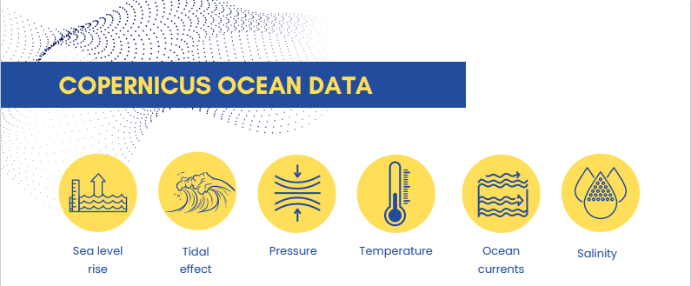
Copernicus Marine Service.
Example
The pictures in this examples are placeholders. When using pictures, make sure to add, when necessary, the correct accreditation.
The Copernicus Marine Environment Monitoring Service provides free, regular and systematic information on the state of the ocean, independent on weather conditions, with data continuously available.
Marine variables are essential for better management of islands and coastal areas, notably those at risk of flooding.

Slide 9
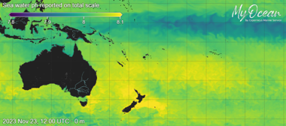
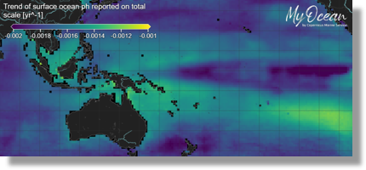
Ocean Monitoring Indicators
MyOcean viewer developed by Mercator, displays maps and features hundreds of products to visualize, analyse and extract ocean information all over the globe.
Ocean acidification (reported & trend)

Slide 10
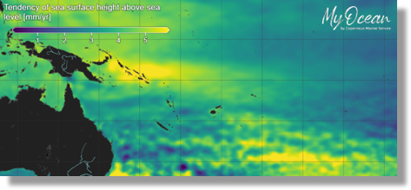
Ocean Monitoring Indicators
MyOcean viewer developed by Mercator, displays maps and features hundreds of products to visualize, analyse and extract ocean information all over the globe.
Sea surface height tendency

Slide 11
Copernicus Emergency Service.
To add text and pictures, please move the grid elements on the side and then place back.
The Copernicus Emergency Management Service provides geospatial data and images to track signals of an impending disaster or evidence of one happening in real time through:
rapid mapping & risk and recovery mapping to support disaster management.
early warning and monitoring through continuous observations and forecasts at global level.
It is key for a quick assessment of large areas for damages to transport and infrastructure as well as for DRR, preparedness and recovery.

Slide 12
Copernicus Marine Service for Pacific Islands
Cyclones Judy and Kevin (Feb.-Mar 2023) tracked by the global wave modelling system distributed on Copernicus Marine Service.

Slide 13
Cyclone Lola (Oct 22nd to 25th, 2023)
Animation of the wave height during cyclone Lola. Waves reached more the 9m in the Vanuatu Islands.

Slide 14
Cyclone Mal (Nov. 13th to 17th 2023)
Animation of the wave height during cyclone Mal. Waves reached more the 8m in the Fiji Islands

Slide 15
Copernicus Marine Service for Pacific Islands
Cyclone Winston (Feb-Mar 2016): Wind field (left), sea surface height (center), time series of sea surface elevation at the black point (right).

Slide 16
International Cooperation.
Example
The pictures in this examples are placeholders. When using pictures, make sure to add, when necessary, the correct accreditation.
Five cloud-based platforms facilitate and standardise the access for Copernicus data users around the globe.
Cooperation Arrangements between the EU and other countries bring additional value in a reciprocal manner and foster the uptake of EO-based products and services.
The EU has developed actions to support users and maximise the benefits through cooperation projects and a local ambassadors system (Copernicus Academy and Relays).

Slide 18
Thank you
To add text and pictures, please move the grid elements on the side and then place back.
Useful links
About Copernicus
Copernicus Emergency Management Service
Copernicus Marine Environment Monitoring Service
OBSERVER: Successes of the Copernicus Academy and Relays network | Copernicus
© European Union 2020
Unless otherwise noted the reuse of this presentation is authorised under the CC BY 4.0 license. For any use or reproduction of elements that are not owned by the EU, permission may need to be sought directly from the respective right holders

Slide 19
Copernicus : Europe´s Eyes on Earth
COPERNICUS is EU Earth Observation and Monitoring programme, looking at our planet and its environment for the benefit of society

Slide 20
Why Copernicus ?
Notes:
Copernicus is the Union Earth Observation and Monitoring Programme
As you can see from this slides, Copernicus helps the Union in fullfilling its policy obligations, such as improving environmental policies and helping people in disasters.
Increasing the knowledge on the state of the Planet facilitates better adaptation to climate change,
In the economic sphere Copernicus fosters downstream applications, thus contributing to growth and job creation

