Slide 1
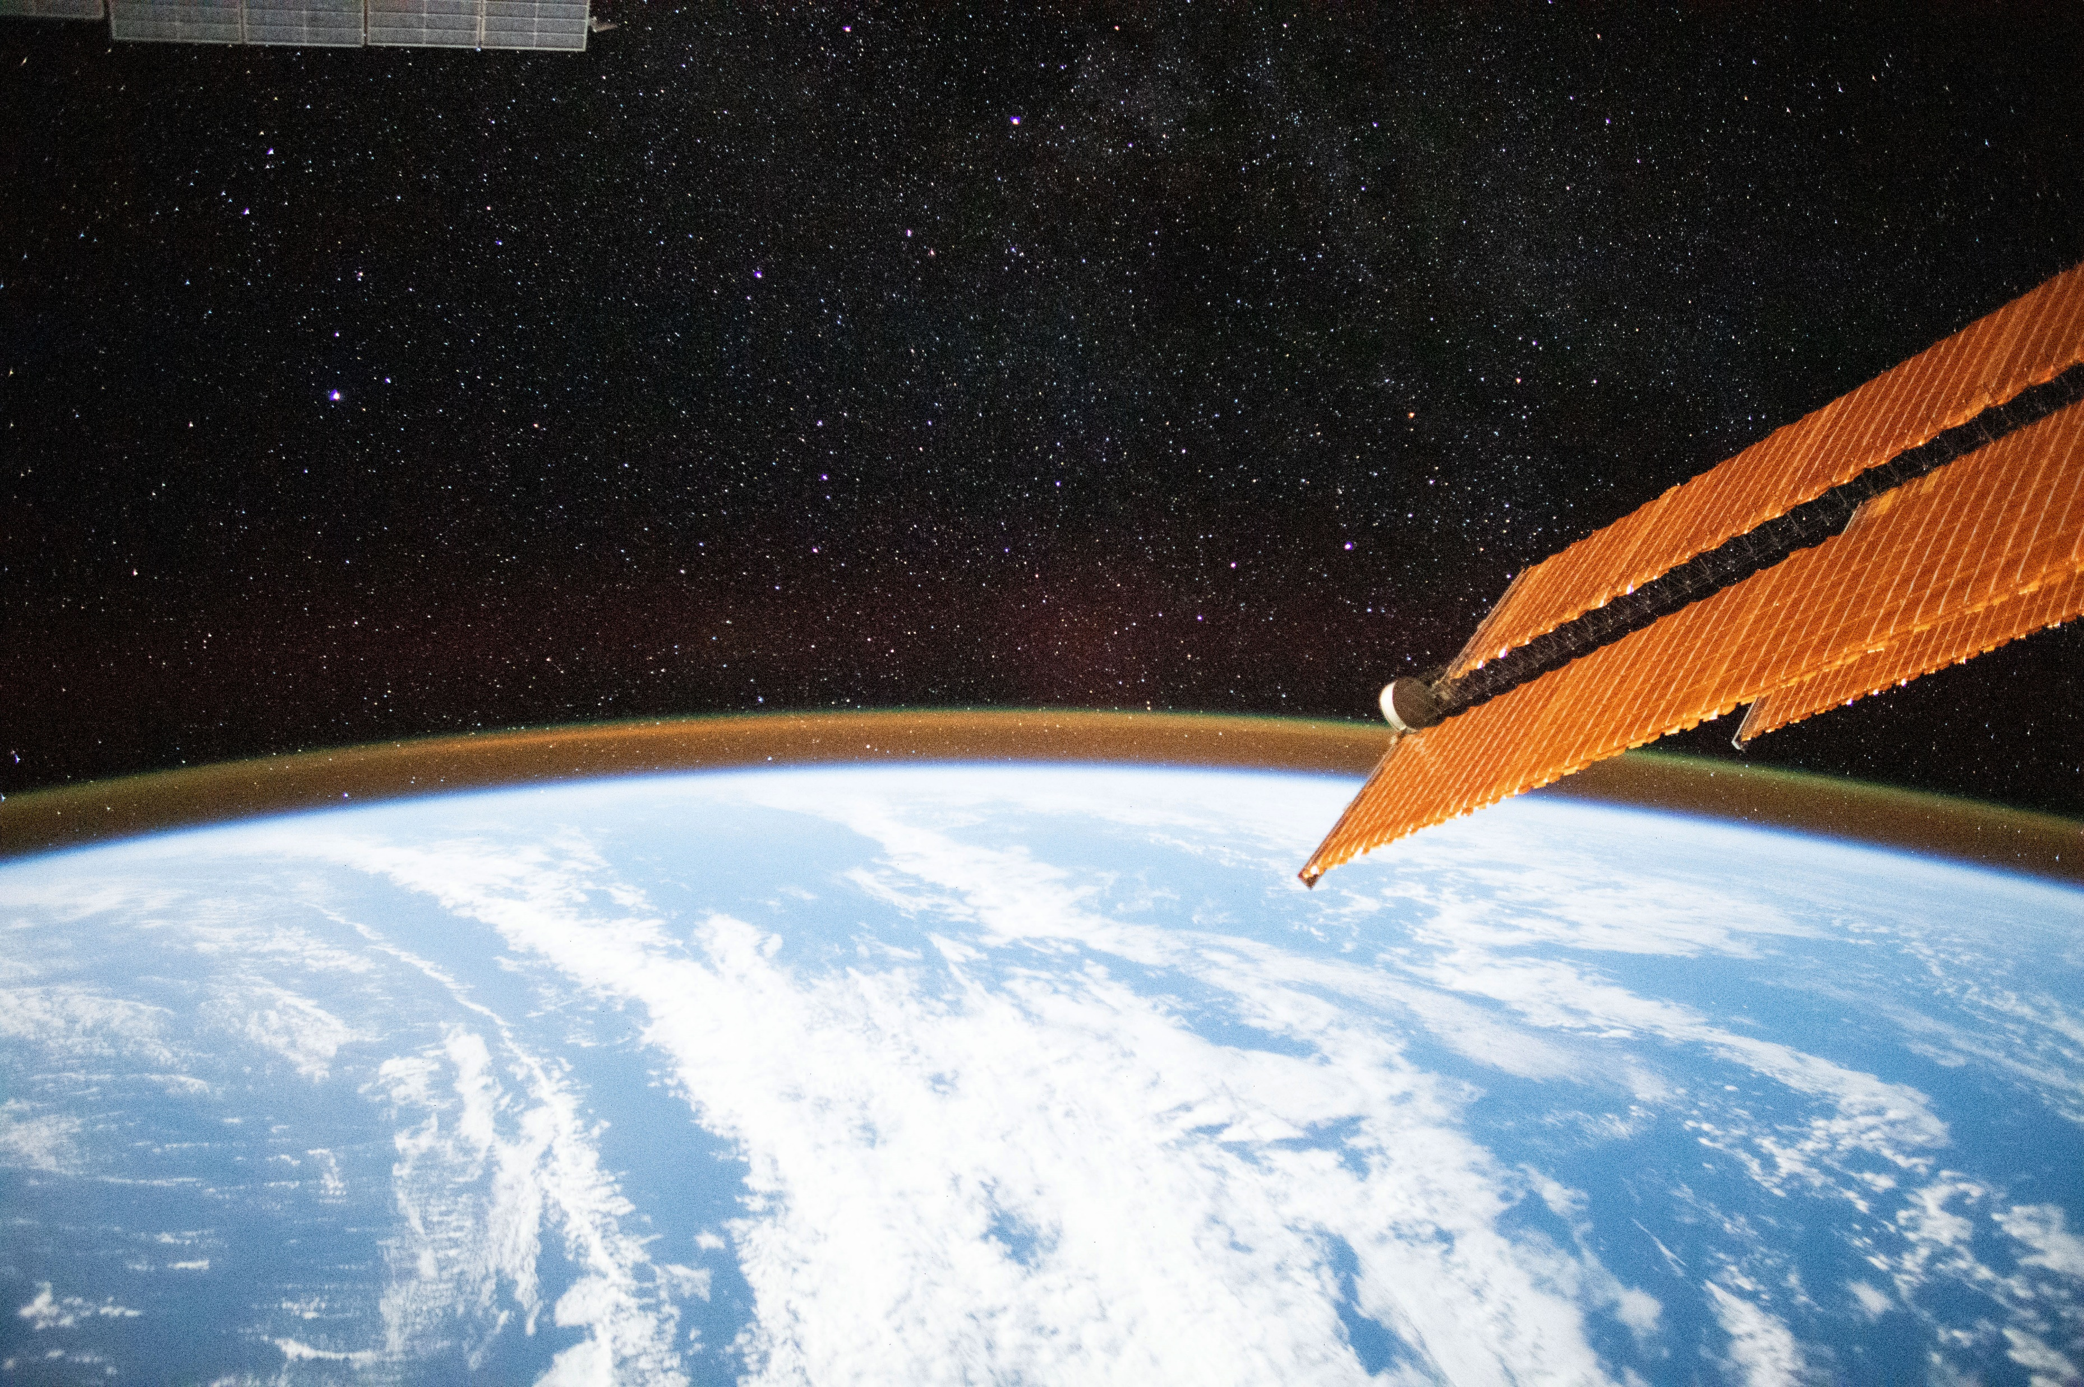
The UN-SPIDER Programme - Facilitating Access to Satellite Technologies and Data for Disaster Risk Reduction and Early Warning
Suva, Fiji - 27th November 2023
Lorant Czaran, czaran@un.org

Slide 2
Office for Outer Space Affairs
Our Work
UNOOSA was initially created as a small expert unit within the UN Secretariat. Over the years it has evolved to a hub for space science and technology, space law and policy. Today we work to advance international cooperation in the peaceful uses of outer space & bring space benefits to everyone.
Secretariat to COPUOS
Works with Member States, IGOs, NGOs (space-related)
Programme on Space Applications
UN-wide coordination - UN-Space
UN Register of Space Objects
UN-SPIDER – with Offices in Austria, China & Germany
International Committee on Global Navigation Satellite Systems (ICG)
Space Mission Planning Advisory Group (SMPAG)
www.unoosa.org

Slide 3
UNOOSA and Space for Sustainable Development
Space for Women
Space Law for New Space Actors
Access to Space for All
UN-SPIDER
Space for Persons with Disabilities
Space Economy
Space for Climate Action
International Committee on GNSS
Space Sustainability
Space for Water
Space for Youth
© NASA

Slide 4
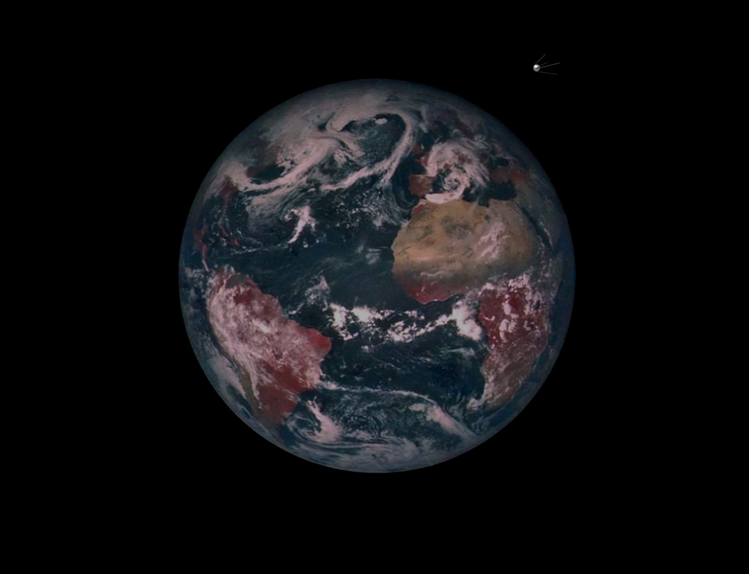
Images NASA Clementine mosaic, sputnik adapted ASB
Notes:
well over 10000 artifical satellites launched since sputnik
1261earth science 186 imaging 90 still working…
around half still in orbit

Slide 5
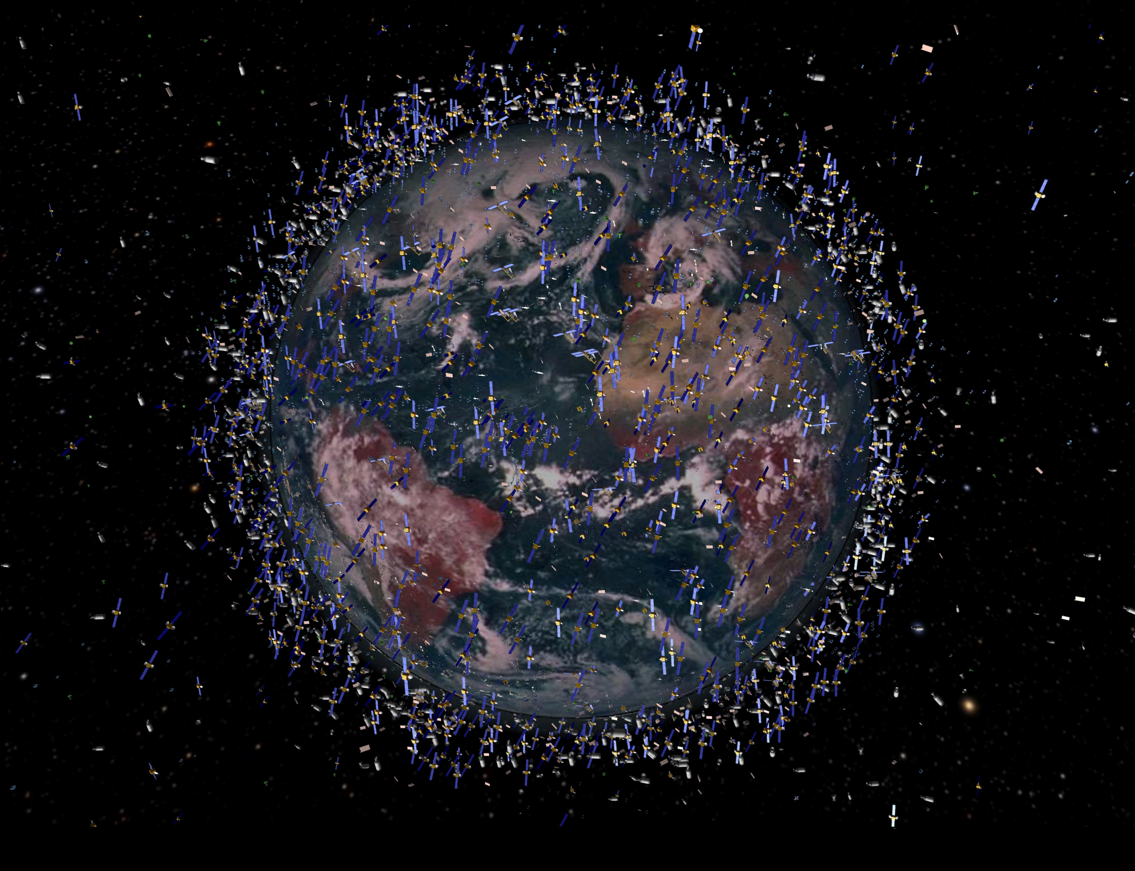
Images NASA Clementine mosaic, ESA beehive adapted ASB (2017) – not included: China ~300+, no StarLink 3500, Planet 200, One-Web 650, etc.
Notes:
well over 9000 artifical satellites launched since sputnik
1261 earth science 186 imaging 90 still working…
around half still in orbit

Slide 6
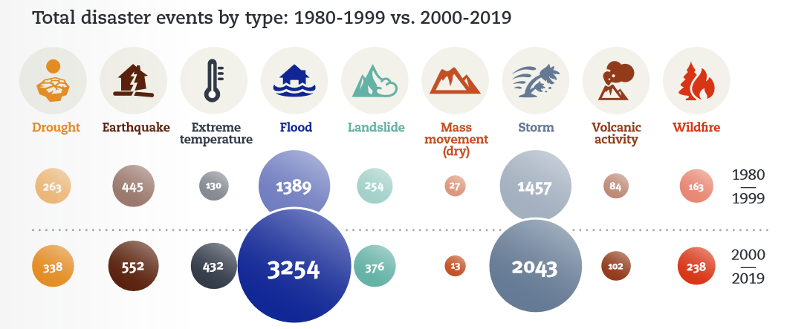
Natural Hazards Trend – 2000-2019
Significant increase in
Number of disasters
people affected and
economic losses
Significant increase in climate related disasters
Floods
Storms
Wildfire
Source: UNDRR 2020 report: The human cost of disasters: an overview of the last 20 years (2000-2019)

Slide 7
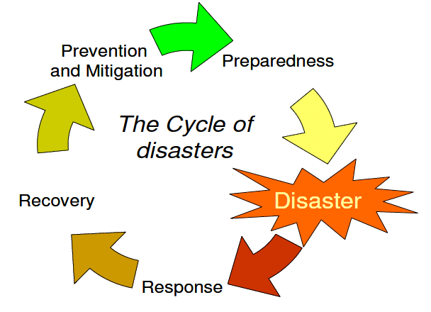
UN-SPIDER
Geoinformation for
Early Warning systems
United Nations Platform for Space-based Information for Disaster Management and Emergency Response (UN-SPIDER)
Ensure that all countries have access to and develop the capacity to use all types of space-based information (EO, GNSS, SatComms) to support the full disaster management cycle
United Nations Resolution 61/110, Dec. 2006
Geoinformation for
Hazard, exposure, vulnerability, and risk assessment
Disaster management cycle
Geoinformation for
Post Disaster Needs Assessment / Damage and Loss Assessment
Geoinformation for
Rapid mapping: Extent and impact

Slide 8
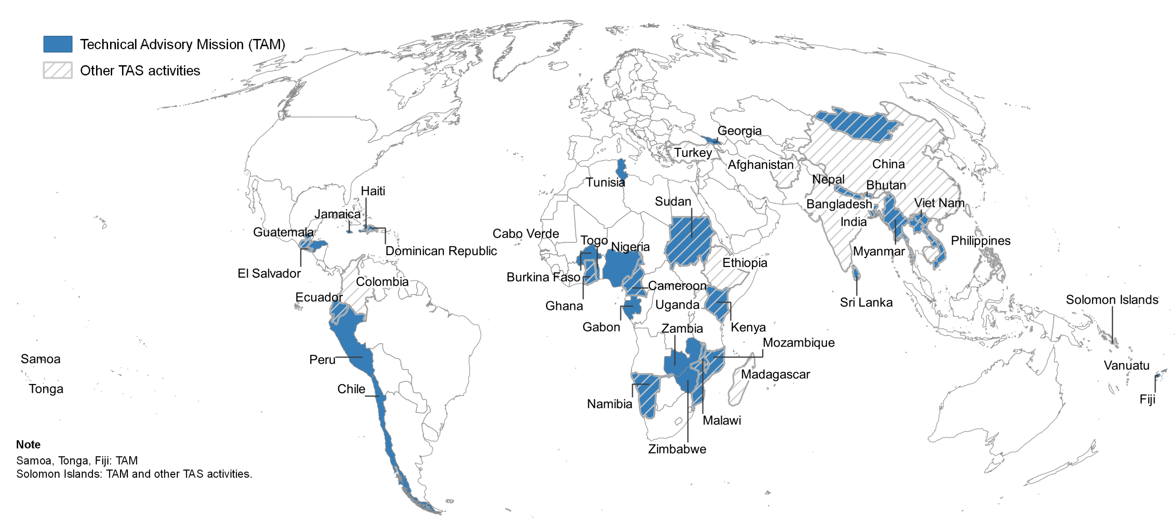
UN-SPIDER
55 (LMI/SID) States benefited from technical advisory services
40 formal Technical Advisory Missions and follow up support
Over 100 technical support and expert missions
ON DEMAND only!
Countries sponsored with data support, attendance at training workshops and relevant conferences
Emergency Response support with satellite data/mapping in over 30 countries
Funding from China, Germany, Austria, France, Türkiye, Japan, plus limited UN regular budget
Knowledge Portal
Fostering Cooperation
Strengthening Capacity
Technical Advisory Support

Slide 9
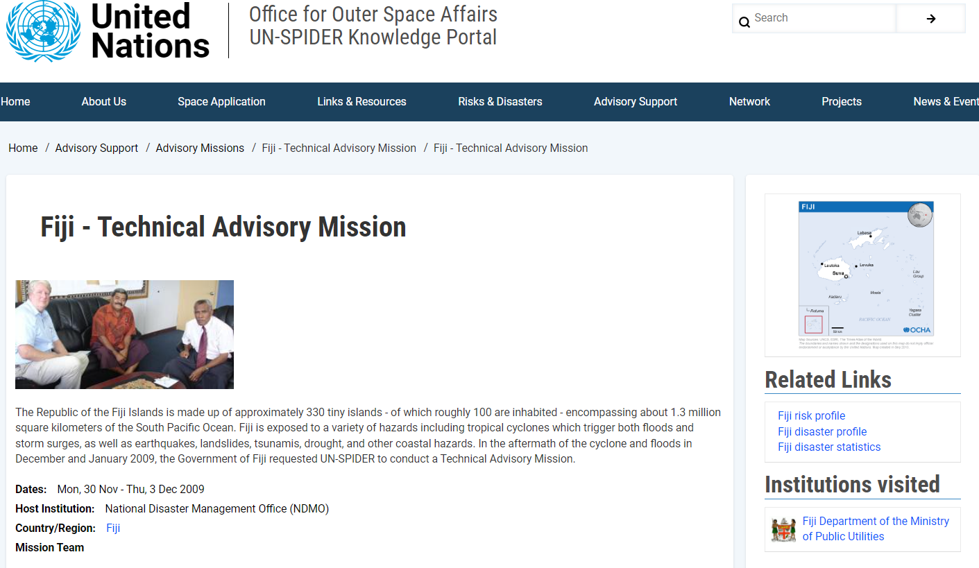
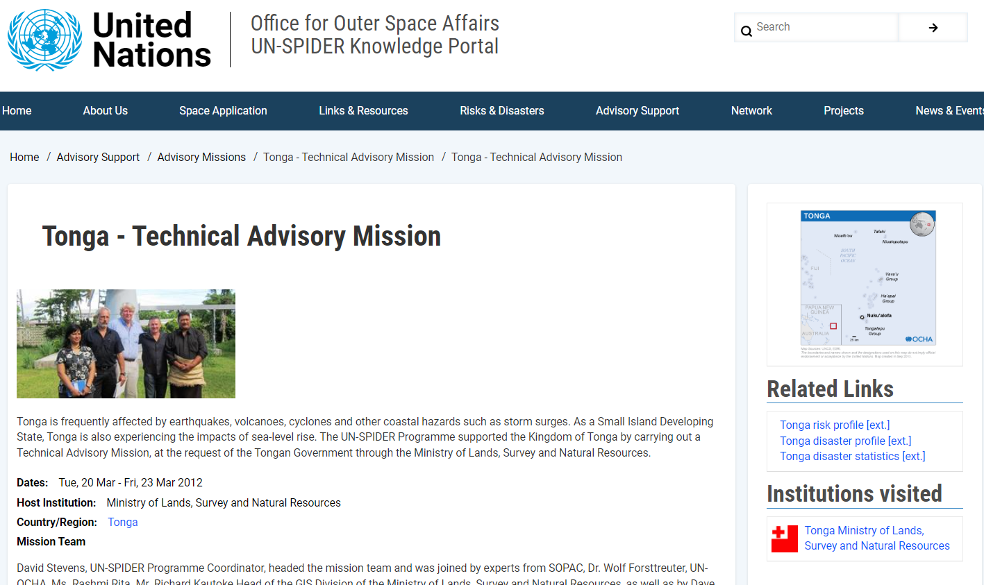

Slide 10
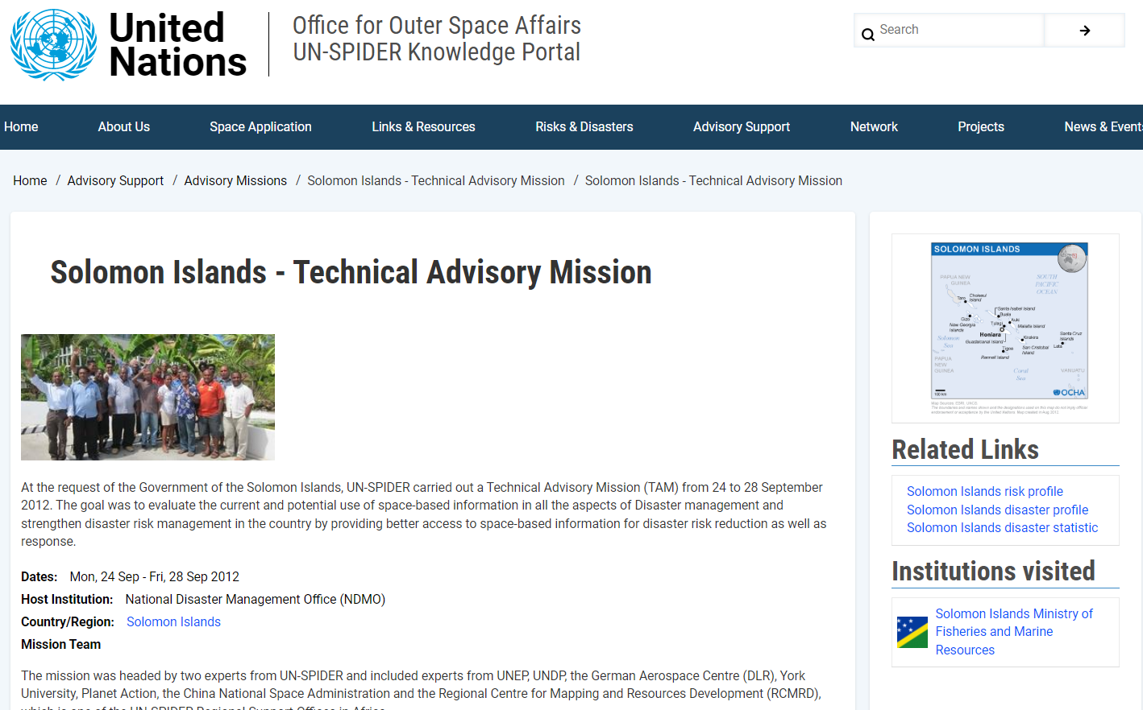

Slide 11
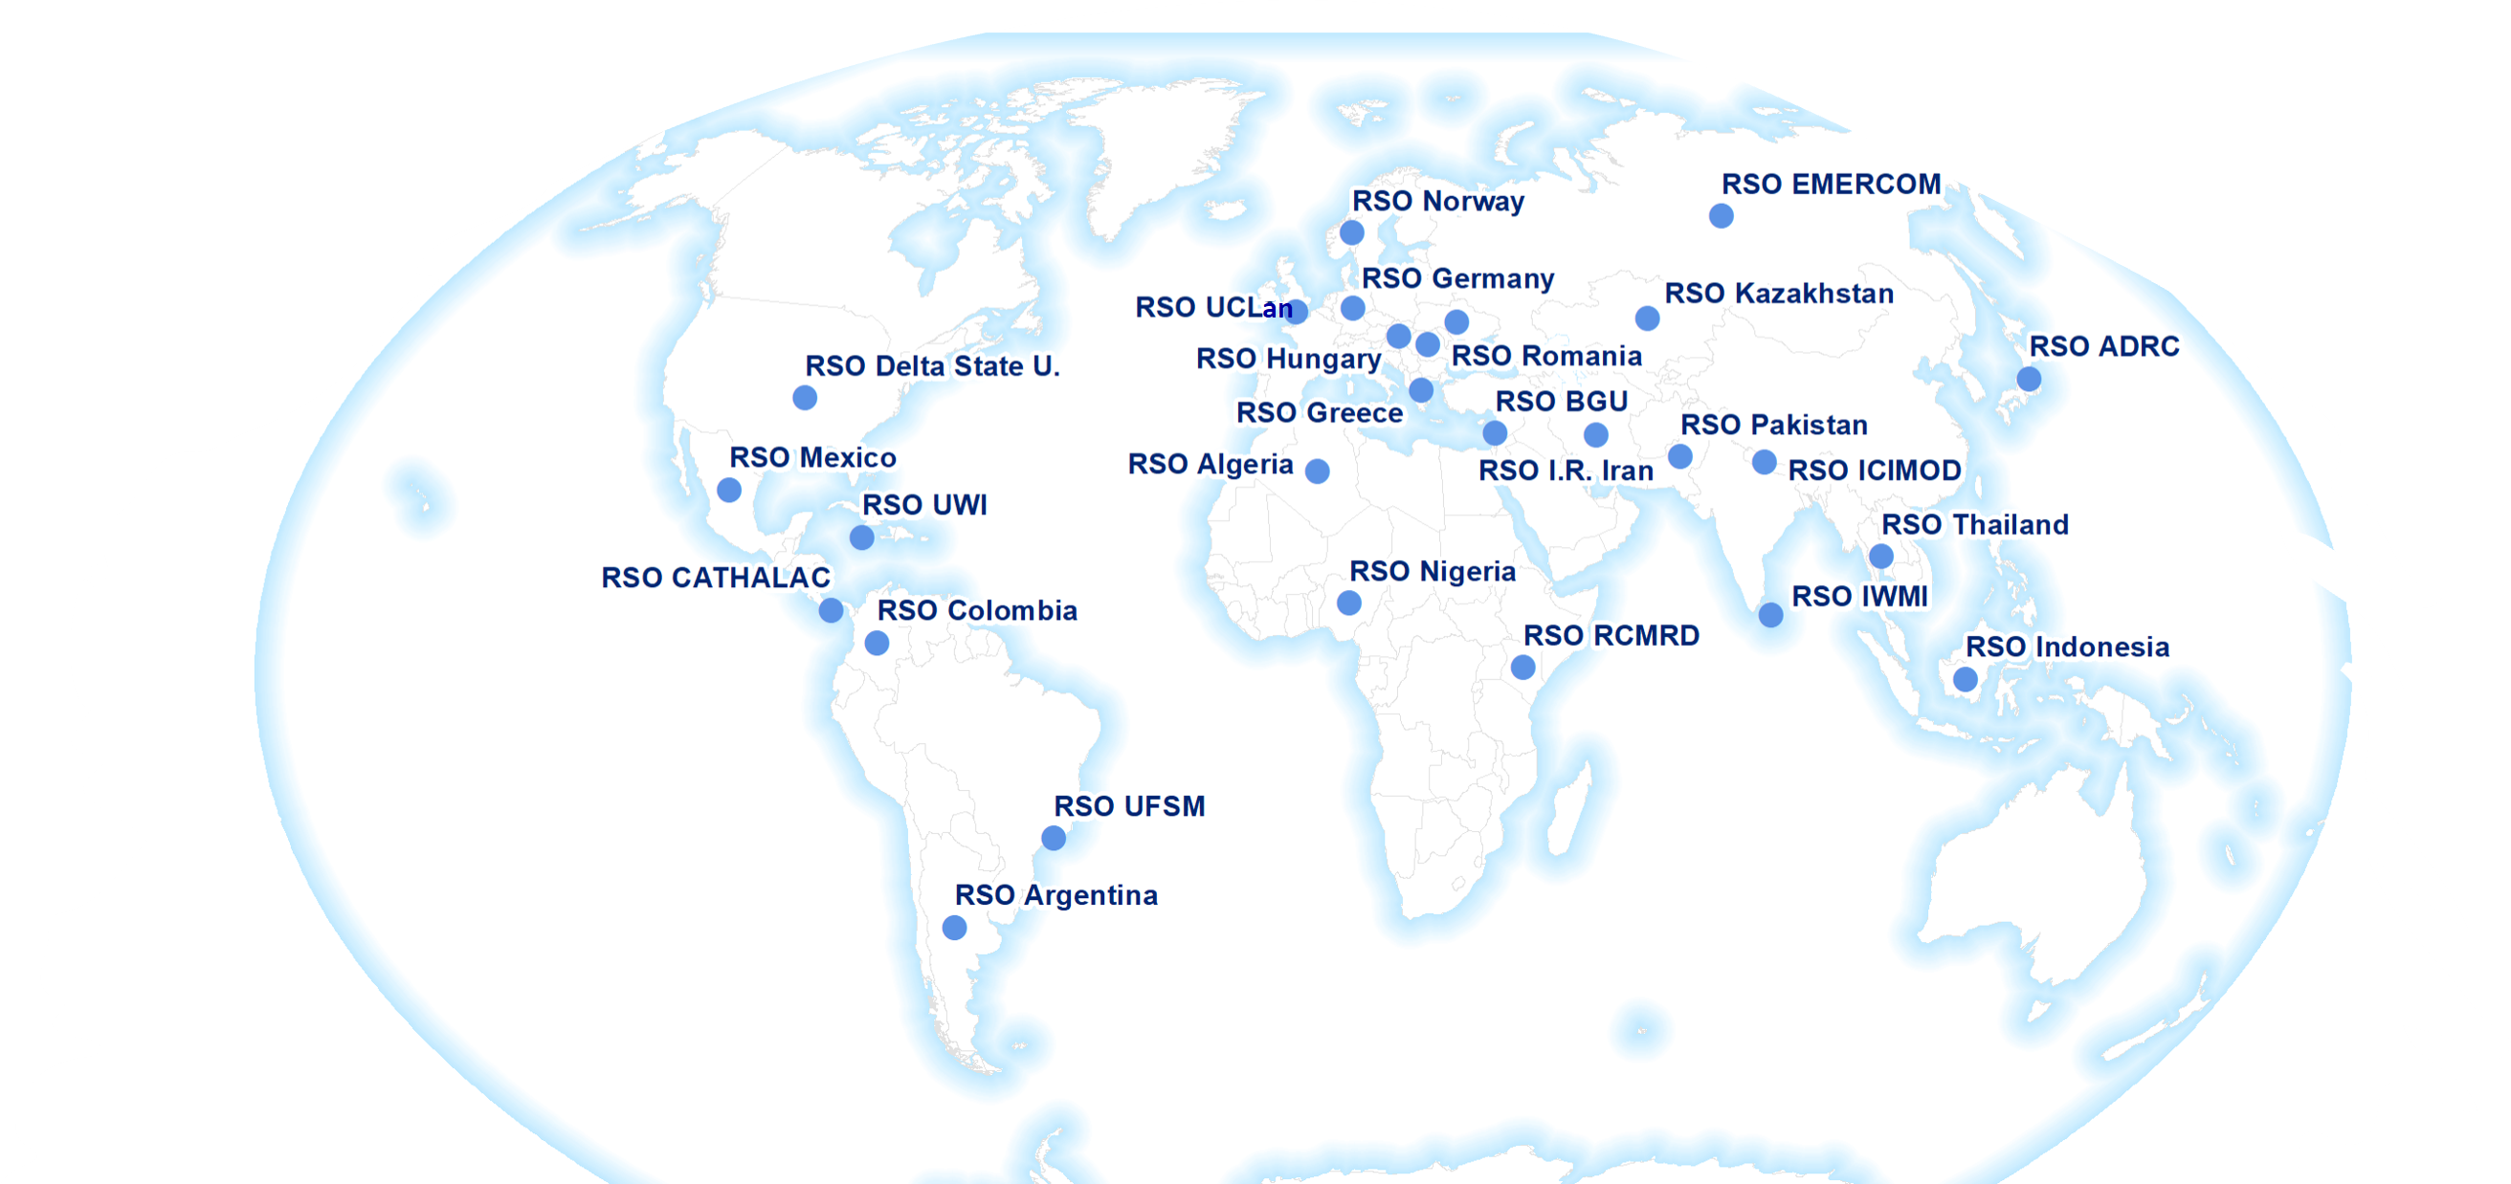
(voluntary) Regional Support Offices to UN-SPIDER
UN-SPIDER

Slide 12
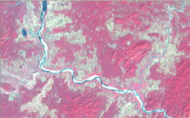
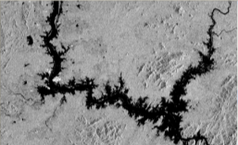
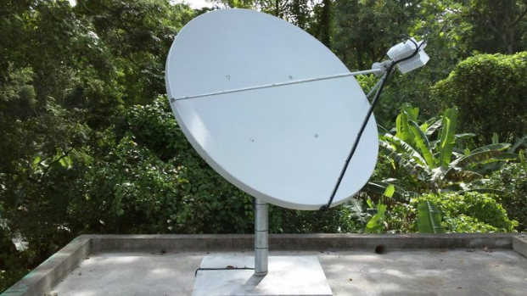
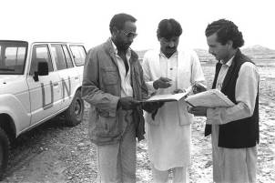
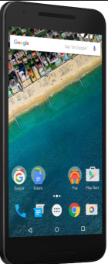
Benefits of Space Technologies
Benefits of Space Technologies
Earth observation
Satellite meteorology
Imagery and GNSS can direct response to affected areas by avoiding damaged transport infrastructure (flooded roads or rail, damaged bridges etc.) or blocked access;
UNOOSA as Secretariat of the International Committee on GNSS (ICG) supports coordination among some 10 GNSS provider States, to improve interoperability
Global Navigation Satellite Systems (GNSS)
Satellite communications

Slide 13
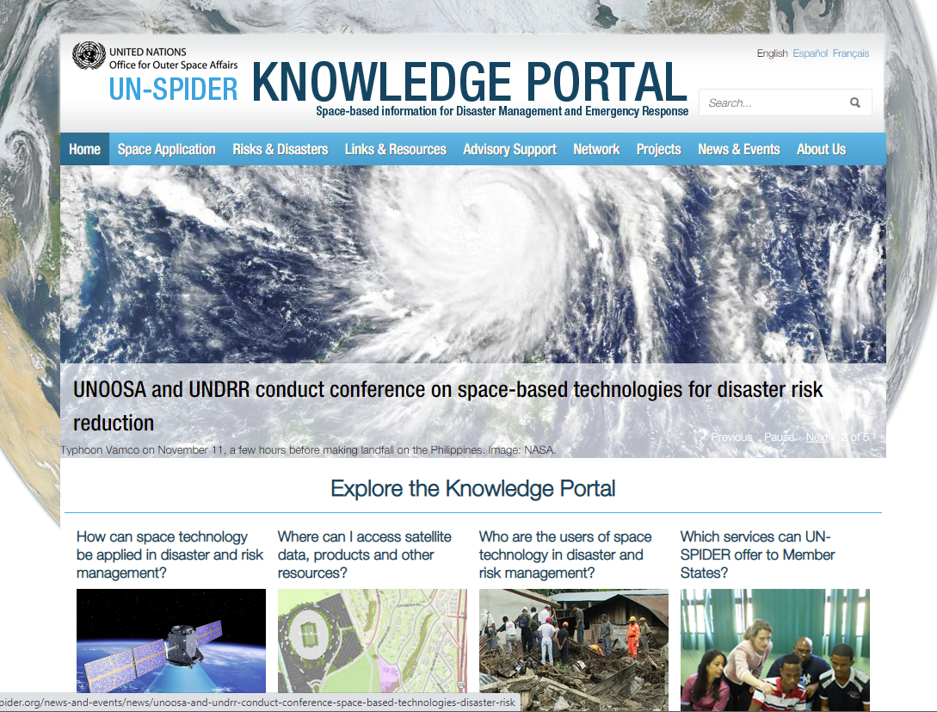
UN-SPIDER Knowledge Portal WWW.UN-SPIDER.ORG
Gateway to space-based information
Available in English, Spanish and French
More than 9,100 content items as of 2022
45,000 visitors per month on average currently
Step-by-step procedures to process satellite imagery
Recommended Practices for working with satellite data

Slide 14
-> UNOOSA - authorized user for the International Charter Space and Major Disasters since 2003 (also UNITAR/UNOSAT) -> UNOOSA - authorized user for activation of the EU Copernicus EMS in international context (response and risk mapping services too) -> UNOOSA - authorized user for activation of Sentinel Asia -> UNOOSA - associate membership in Committee on Earth Observing Satellites (CEOS), WG Disasters (Chair from 2023 Nov.), WGISS and WGCapD, observers in Group on Earth Observations (GEO) and U.N. Committee on Global Geospatial Information Management (GGIM) -> UN Geospatial Network (since 2000), and UN-Space coordination
UNOOSA / UN-SPIDER engagements

Slide 15
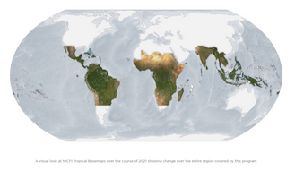
Satellite Imagery – Select Resources
-> Norway-sponsored free access to Planet mosaics and imagery in 2-3 m. resolution between 35N and 35S, mainly for forest monitoring, but usable on non-profit basis by anyone 50 Mil. US$/year since 2019
-> UN in discussions with Norway on Planet broader free access for humanitarian uses
-> UNOOSA working for affordable access to high-resolution imagery with other 10+ States operating Government-owned submeter imaging satellites (Armenia, Azerbaijan, China, Egypt, Israel, Kenya, Nigeria, Pakistan, Thailand, UAE etc.)

Slide 16
Satellite Imagery – Select Resources
Very High Resolution (commercial) Resources
-> UNOOSA is a partner of Maxar Open Data Programme (UNOOSA) -> UNOOSA MoU with Airbus in place for access to VHR imagery and DEMs for major disasters
-> Other MoU’s under consideration - ICEYE, BlackSky, SatelliteVU, Planet etc.
-> UN System Contracts (MDA, Airbus etc.) for satellite imagery purchase
-> UNOOSA working through CNSA to increase access to Chinese Government- and private satellite imaging providers as well, 100+, an untapped resource

Slide 17
Earth observation – Present and Future Trends
Satellite meteorology (every 10-15 minutes), Digital Agriculture, crop forecasting etc.
Imaging (especially Very high Resolution – VHR in the submeter domain, down to 28cm today)
VHR is commercial domain, important to have good coordination, licensing allowing data sharing, and cost-effective approaches
Use of multi-user licensing when accessing satellite imagery is key
Various Emergency response mechanisms for EO data exist (Copernicus, International Charter, Sentinel Asia), commercial entities also collaborate – not for all 400-500 events
In the past, “scenes”, and single images – the future is about mega-constellations, and daily imaging of the Earth in VHR (Planet already doing it in 2-3 m)
National Mapping authorities can now update topo maps in months, not years
Given all new satellite imaging constellations, our focus must shift to online services, subscriptions for access, online analytics, cloud storage, AI/ML, digital twins etc.

Slide 18
Shaping the decades
Space2030 Agenda
Sustainable Development Goals (SDGs) – Agenda 2030;
Sendai Framework for Disaster Risk Reduction 2015-2030;
Paris Climate Change Agreement
Space2030 Agenda led by COPUOS and UNOOSA;
reporting requirements, obligations at national and subnational level – INDICATORS to measure progress

Slide 19
Sendai Framework - Towards EW4All
International Network on Multi-Hazard Early Warning Systems (IN-MHEWS)
UNDRR

Slide 20
EW4All – UN Secretary General’s initiative
UNDRR and WMO lead, several UN entities including UNOOSA to contribute
To end 2027
~3 Billion in funds expected
Possible satellite technology support to countries:
GNSS – seismicity, landslides, earthquakes
SatComms – IOT, data transfer, RT data access, Weather Stations
EO – Meteo, monitoring, forest fires, floods, storms, landslides etc.

Slide 21
czaran@un.org

